Slide 1
Blockchain: everyone wants to sell me that - but is that really right for my application?
Dr. Marco Ermini, CISA, CISM, CISSP, ITILv3, GCIH, RCSS, PhD
Senior Security and Compliance Officer, Orange Business Services

Slide 2
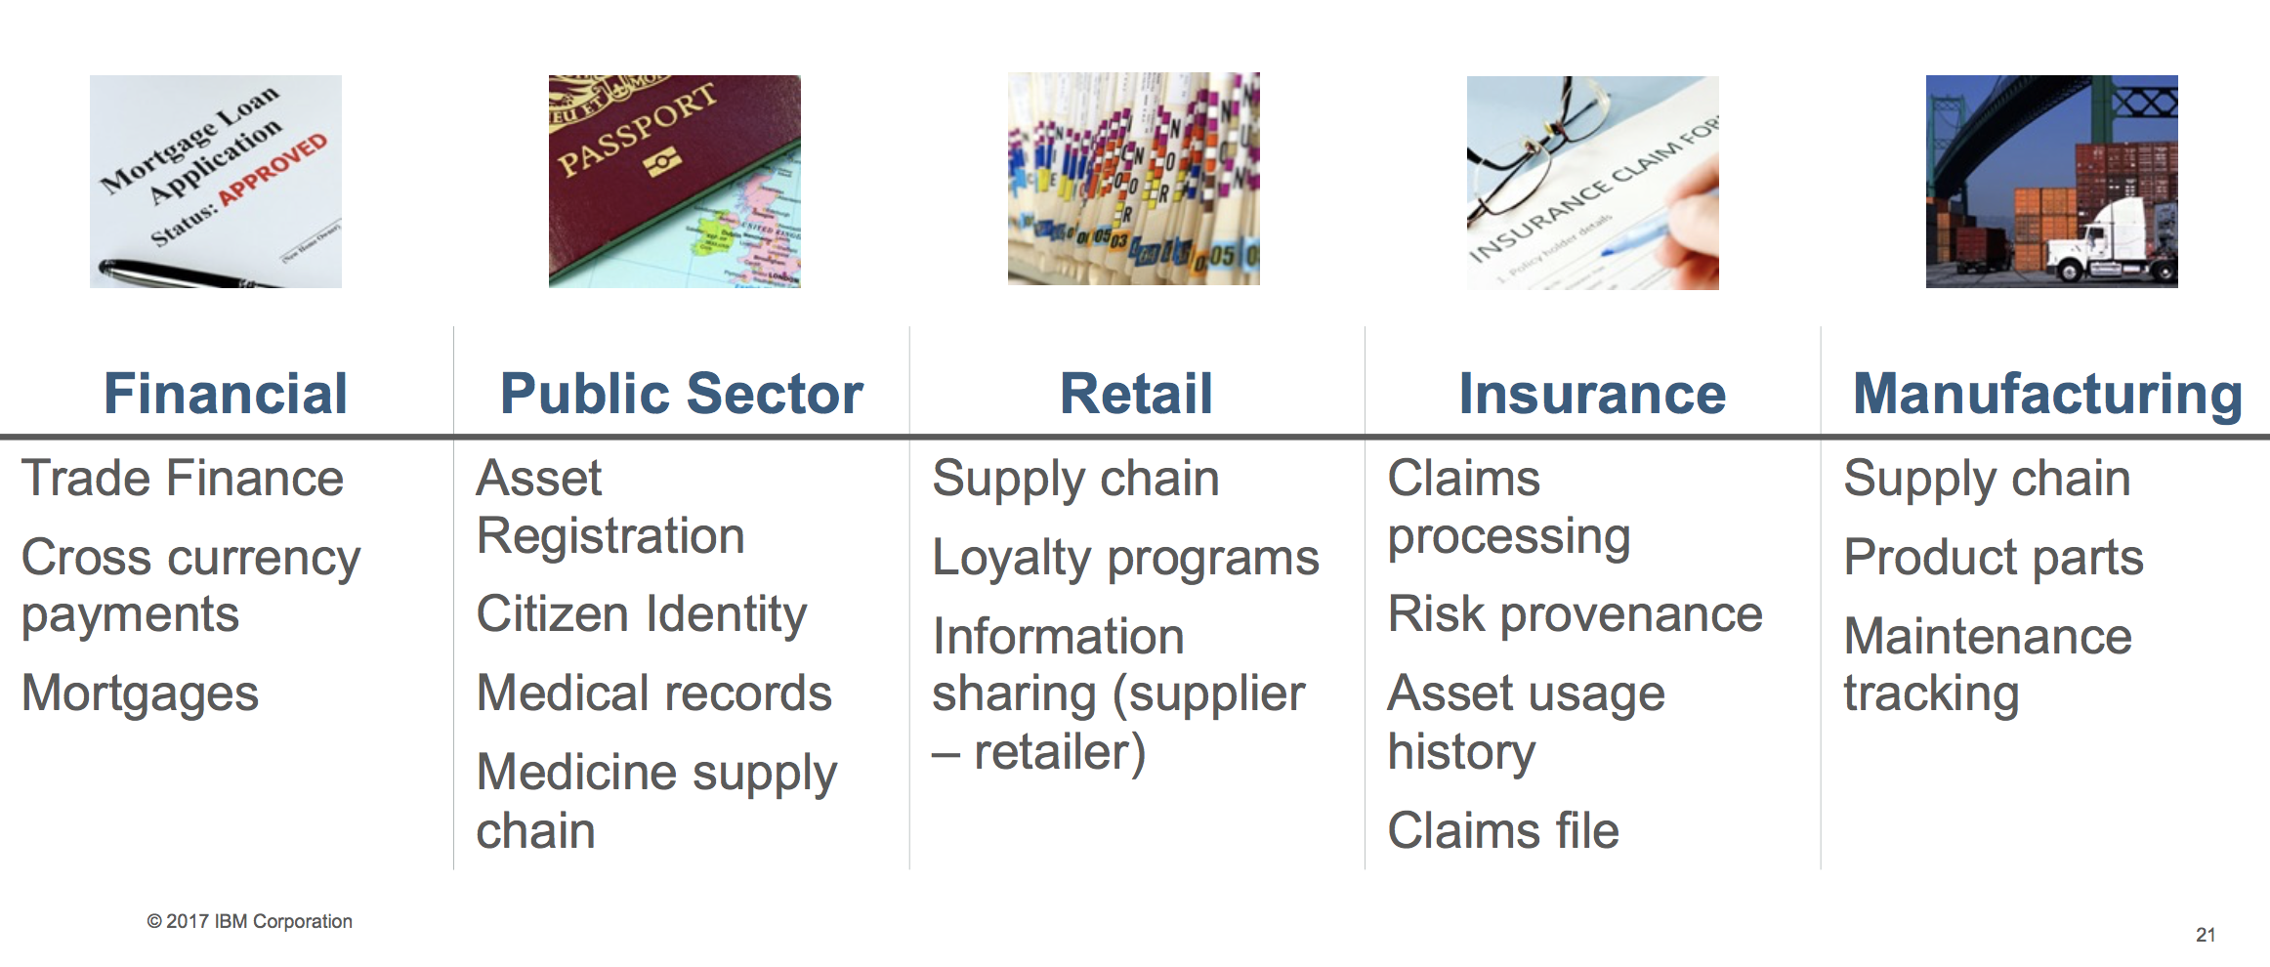
Why? “Blockchain revolution”
Notes:
DLT applications for business >> BaaS targets this
While bitcoin is currently the most notable blockchain-based ecosystem, there are increasing varieties of blockchain ecosystems and technologies that are becoming available. In many cases, these blockchain ecosystems and technologies are significantly different from each other. Some of these will likely be here to stay, while others will fail to achieve critical mass. For SRM leaders, each of these offerings will have different implications from an information security perspective.
At this stage, a number of use cases are being theorized and some are in an early stage of PoC. An increasing number of organizations are beginning to experiment with blockchain. Any "trust business" (centralized institutions and bureaucracies such as banks, clearinghouses and government authorities) will have business processes that lend themselves to decentralization, for which blockchain provides an alternative method.
Source: IBM

Slide 3
Is blockchain overhyped?
Another day, another article praising blockchain’s untapped potential: it will start a new era, revolution the financial system, disrupt every industry and will change the world.
…or will it not? and is that really what I need for my next project?
Notes:
Yes, blockchain is overhyped. The blockchain is being praised as a technological innovation which allows revolutionizing how society trades and interacts.
This reputation is in particular attributable to some of their specific properties such as of allowing mutually mistrusting entities to exchange information and interact without relying on a trusted third party.
A blockchain moreover provides an integrity protected data storage and allows to provide process transparency.

Slide 4
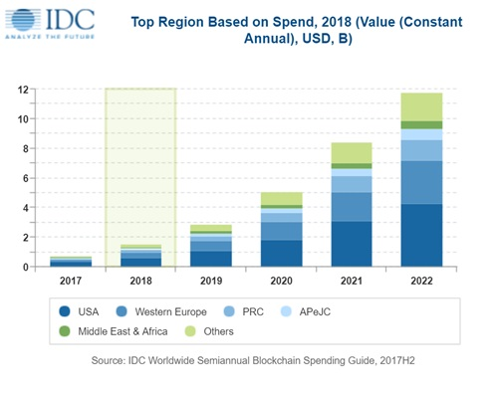
The size of the “hype”
Blockchain landed Top 10 Gartner’s technology trend in 2016
However
A group of healthcare CIOs picked it as the most over-hyped technology
In transportation, over half respondents didn’t know what to do with it
Long Island Ice Tea renames to “Long Blockchain Corp.”, stocks go up 200%
Investments are flooding
market growth only in 2017: from 16 billion to 600 billion USD
2.1 billion USD global spending in solutions in 2018
42.8% yearly expansion until 2022
3x related LinkedIn job postings in 2017
13% senior IT leaders with clear/current plans, 300 companies in PoC
Financial services and manufacturing lead the pilot projects
Notes:
A few recent statistics show that actual CIO and leader perceptions of blockchain might be at odds with analyst predictions. A group of healthcare CIOs picked blockchain as the most over-hyped technology trend of the moment.
In the transportation sector, over half of respondents to a recent survey said that blockchain was interesting, but they didn’t know what to do with it, according to Gartner.
Perhaps these execs are skeptical due to not only online buzz but also the recent flurry of attempts to capitalize on blockchain by changing company names. Case in point: A 200 percent instant rise in stock price when the brand Long Island Iced Tea changed its name to “Long Blockchain Corp.” They were just one of several companies that sought to capitalize on the “crypto craze.” The SEC has since said it will be scrutinizing such moves.
Still, with investment flooding into the cryptocurrency market, the noise around blockchain isn’t likely to die down anytime soon. For CIOs looking to cut through the hype, we’ve rounded up some recent numbers and stats that highlight the rapid rise of blockchain to date – and where it might be headed in the near future.
$600 billion: The size of the entire cryptocurrency market by the end of 2017, according to CoinMarketCap. Consider the pace of growth over the last 12 months: It started the year at just $16 billion.
$2.1 billion: Global spending on blockchain solutions in 2018, according to IDC. Stacey Soohoo, research manager, customer insights and analysis at IDC, says, “The year 2018 will be a crucial stage for enterprises as they make a huge leap from proof-of-concept projects to full blockchain deployments. As a leader in blockchain innovation and integration, the US will continue to invest in blockchain throughout the forecast, spending heavily in financial services, manufacturing, and other industries.”
42.8 percent: The expansion of the blockchain space every year to 2022, according to a Netscribes prediction. Looking beyond this year, the market research group believes the “key factors behind this ascension will be blockchain adoption in financial transactions and cross-border payments.”
3x: The number of blockchain-related LinkedIn job postings more than tripled over the last year. Organizations badly in need of blockchain developers are setting up training centers, outsourcing, or even nabbing talent before they’ve graduated college.
13 percent: Senior IT leaders who have clear and current plans to implement blockchain, according to IDG Connect research. Based on this statistic, plenty of CIOs are taking their time with blockchain.
However, especially if you are a CIO in financial services or manufacturing, 2018 may be the year that blockchain moves from pilot projects to production in your organization, as Paul Brody, principal and global innovation leader, blockchain technology at EY, recently shared with us.
Almost 300 companies are already trying to build, regulate, define or integrate DLT, through participation in consortia or pilots of their own.
Sources:
https://enterprisersproject.com/article/2018/2/5-blockchain-statistics-cio-reality-check
https://www.gartner.com/smarterwithgartner/gartners-top-10-technology-trends-2017/
http://www.healthexec.com/topics/health-it/blockchain-named-most-overhyped-it-trend-cios
https://www.freightwaves.com/news/2017/11/28/gartner-research-director-delivers-upbeat-outlook-for-blockchain
https://www.huffingtonpost.com/entry/why-2018-will-be-the-year-of-the-blockchain_us_5a4b1b72e4b0df0de8b06c91
https://www.reuters.com/article/us-usa-sec-blockchain/sec-is-scrutinizing-overnight-blockchain-companies-chairman-idUSKBN1FB2XI
https://www.ccn.com/cryptocurrency-market-cap-climbs-to-600-billion-as-bitcoin-price-recovery-continues/
https://www.vccircle.com/global-spending-on-blockchain-solutions-to-reach-2-1-bn-in-2018-idc-report/
https://cryptovest.com/news/netscribes-gartner-see-good-times-ahead-for-blockchain-market/
https://venturebeat.com/2018/01/28/3-ways-organizations-are-dealing-with-the-blockchain-developer-shortage/
http://www.idgconnect.com/abstract/29326/a-suite-guide-blockchain-2018
https://enterprisersproject.com/article/2017/12/5-blockchain-trends-watch-2018

Slide 5
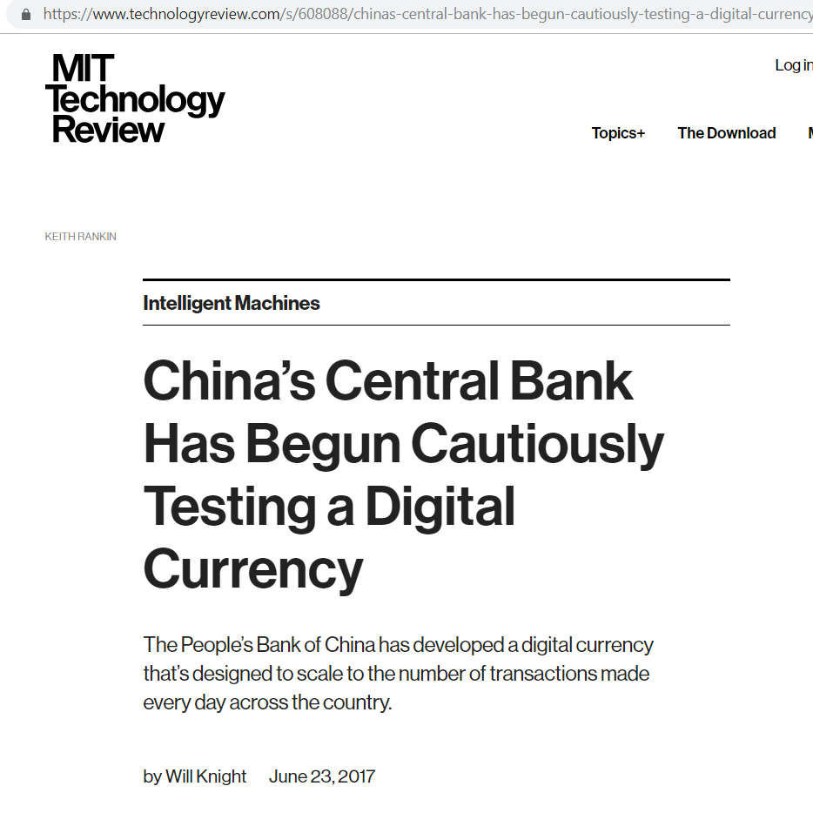

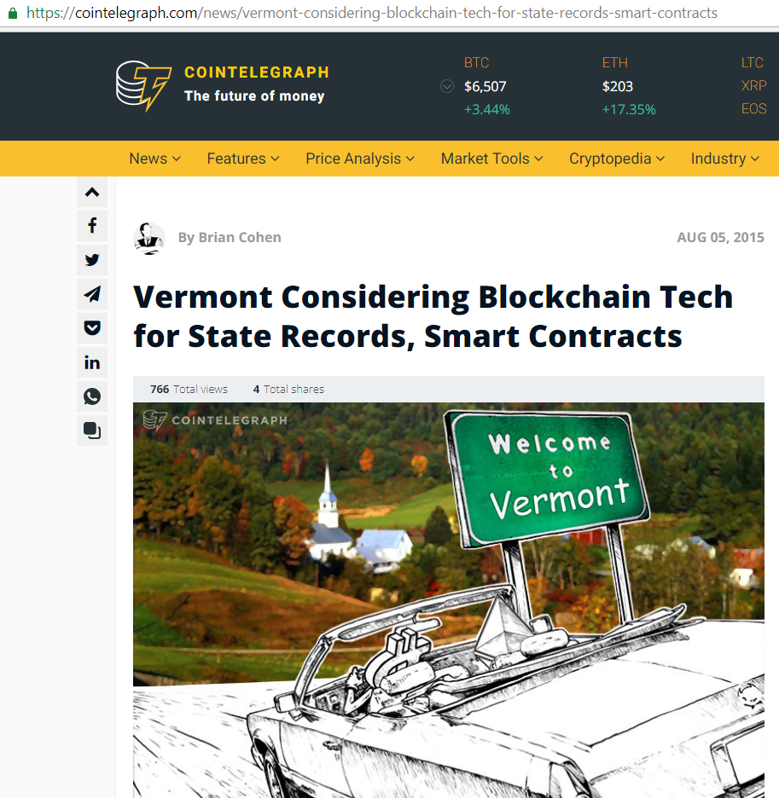
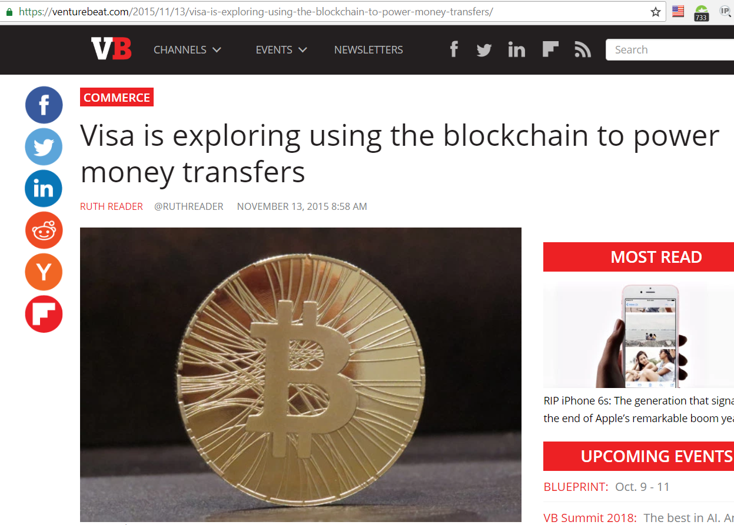




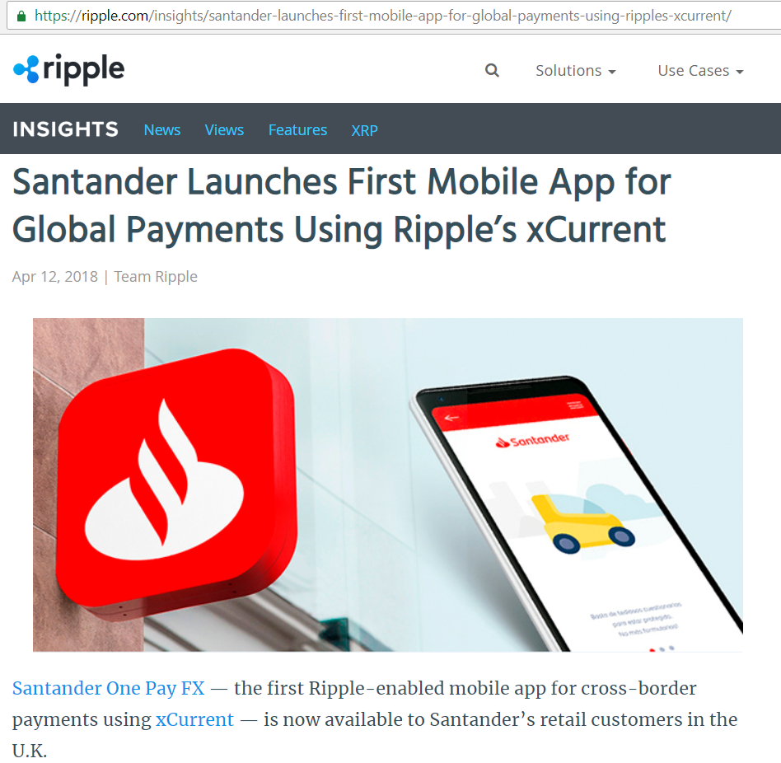
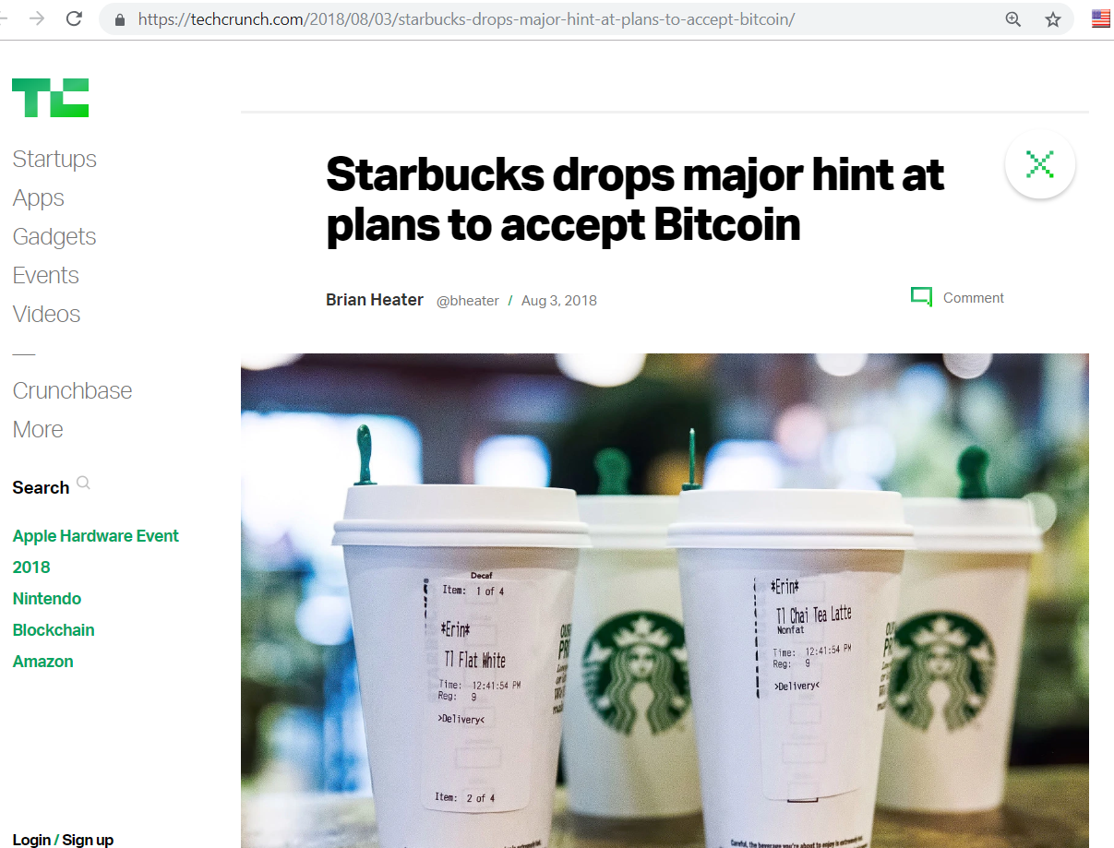
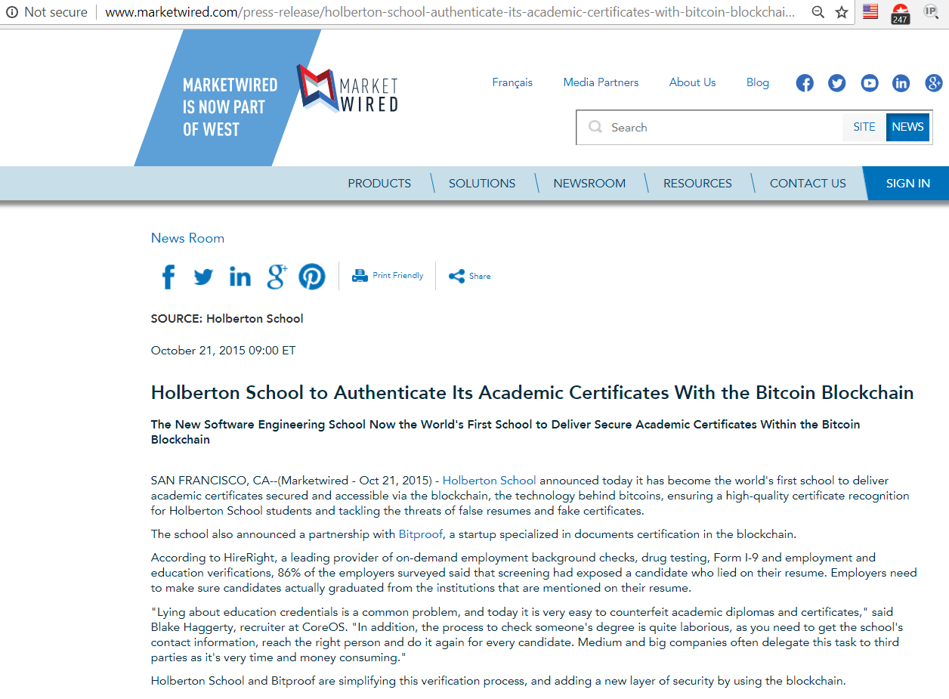
Lots of Pilot Projects
Notes:
https://techcrunch.com/2018/05/20/with-at-least-1-3-billion-invested-globally-in-2018-vc-funding-for-blockchain-blows-past-2017-totals/
https://ripple.com/insights/santander-launches-first-mobile-app-for-global-payments-using-ripples-xcurrent/
https://cointelegraph.com/news/factoms-latest-partnership-takes-on-us-healthcare
http://www.marketwired.com/press-release/holberton-school-authenticate-its-academic-certificates-with-bitcoin-blockchain-2065768.htm
https://coinjournal.net/singapores-ida-teams-banks-develop-blockchain-based-invoice-platform/

Slide 6


Consortiums are starting

Slide 7
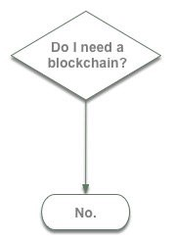
Fierce critics exist
“Blockchain Is The Most Over-Hyped Technology Ever, No Better than a Spreadsheet/Database”
“Shitcoin” is a pejorative term used to describe an altcoin that has become worthless.
Ten years in, nobody has come up with a use for blockchain
Blockchain is not only crappy technology but a bad vision for the future
There is no single person in existence who had a problem they wanted to solve, discovered that an available blockchain solution was the best way to solve it, and therefore became a blockchain enthusiast.
Notes:
Shitcoin value may disappear because interest failed to materialize, because the altcoin itself was not created in good faith, or because the price was based on speculation.
D. Birch model: https://medium.com/@sbmeunier/when-do-you-need-blockchain-decision-models-a5c40e7c9ba1
https://www.banking.senate.gov/imo/media/doc/Roubini%20Testimony%2010-11-18.pdf
https://www.investopedia.com/terms/s/shitcoin.asp
https://hackernoon.com/ten-years-in-nobody-has-come-up-with-a-use-case-for-blockchain-ee98c180100
https://medium.com/@kaistinchcombe/decentralized-and-trustless-crypto-paradise-is-actually-a-medieval-hellhole-c1ca122efdec

Slide 8
Key challenges
Technology overall is at an early stage; security risks and best practices vary dramatically
Technologies making up the ecosystem carry significant risks
Cryptocurrency has made many public missteps
There is no legal/compliance framework or deployment best practices
Smart contracts are code, with all that this carries on
Notes:
Though in the public domain for nearly a decade, blockchain technology overall remains in an early stage. Security risks and best practices vary dramatically, exposing a myriad of vulnerabilities based in the underlining cryptography or network protocols.
While the blockchain ledger uses sound cryptography, the collection of technologies that make up the entire blockchain still carries significant risks. This causes many to underestimate and underappreciate both the risks of blockchain-based systems and the value of applying some basic security protocols.
Cryptocurrency, typically based on blockchain technology, has made many public missteps. Tens of millions of dollars have been stranded due to some misunderstandings, basic code errors and security mistakes.
There is no agreement on a legal/compliance framework for blockchain. Not even deployment best practices!
Smart contracts, a blockchain-related technology, are code. They carry all the risks that come with a software development life cycle.

Slide 9
Key questions
What is blockchain and why is it important?
What does the technology landscape look like, and how does blockchain change the way industry and commerce operate?
What is the next phase of blockchain evolution?
What steps should a CIO or business leader take to prepare for a blockchain future?

Slide 10
What is the aim of this talk
understand the basic
there will be some hand waving
being able to answer the excessive counter-critiques
identify potentially successful blockchain project
how to find a good candidate within your organization
Notes:
understand the basic of blockchains as compared to other traditional (both centralized and distributed) technologies such as relational databases, PKI, and identity management systems.
There will be some hand waving due to time constraints
make the audience able to answer the excessive counter-critiques, such as that there is no good use for blockchains at all. This is obviously not true and there are very good examples of successful projects, from which we can learn the essentials.
identify the characteristics of a potentially successful blockchain project, versus one that should be tackled with "traditional" technology.
what are the main factors that tell an initiative is or is not a good candidate for a blockchain project, and how to find a topic which may be a good candidate within your organization.

Slide 11

Notes:
Source: Shuttershock

Slide 12

Opportunities and Risks

Slide 13
Valid Criticisms – Debunking Myths
Blockchain in itself…
…does not provide security
…can be slow
…no governance
…still requires IT infrastructure
…is not secure
Notes:
Blockchain in itself
does not necessarily provide more enterprise security,
it may be too slow to use,
governance processes are not automatically solved,
it does not mean you can zero your IT infrastructure and you can ignore things such as backups –
and neither that attacks are inherently avoided (both from external and internal entities).
In this presentation, it will be analysed whether a blockchain is indeed the appropriate technical solution for particular application scenarios. The presentation will provide a structured methodology to determine the appropriate technical solution to solve a particular application problem. Given the methodology, we analyse some example use cases to get the public started with it, we present the attack surface for general blockchain technologies, and conclude the with an outlook for further opportunities.

Slide 14
Benefits and uses for blockchain do exist
Mitigating Trust and Transparency Issues
Providing community control and Data Integrity
Use cases abound
mostly, where a centralized trust arbiter does not appeal anymore
Ability for independent nodes to converge on a consensus
Certainty of determination that a transaction does or does not exist
Ensuring the Integrity of Digital Assets – fraud mitigation
Increasing Fault Tolerance and Resilience – e.g. DoS protection
Can enabling entire new business opportunities
Notes:
Benefits and Uses - Some of the known core advantages of a blockchain architecture include the following:
Mitigating Trust and Transparency Issues. Blockchain is based on a distributed and decentralized architecture. Depending on the particular blockchain platform, all transactions are made available to interested parties via the blockchain. The notion of "interested parties" can vary depending on requirements (for example, enterprise-oriented blockchains may only be limited to the enterprise itself). The blockchain, in theory, is not controlled by a central authority, thus providing transparency, community control and data integrity.
Use cases abound, and technology evangelists have promoted the idea of decentralization wherever there is a centralized trust arbiter. For example, the U.K. government is currently considering privatized alternatives to its Land Registry. A blockchain-enabled replacement would allow any interested individual to discover ownership of land, while also ensuring that transfer of ownership does not occur without the authorized consent of interested parties (for example, a financial institution holding the property as security on a loan). Other potential uses in the information security space include notification of fraud between consortium members, verification or repudiation of identity proofing, and the distribution, verification and revocation of public keys in an extension to public-key infrastructure (PKI).
Other benefits related to trust and transparency are:
The ability for independent nodes to converge on a consensus of the latest version of a large dataset.
The ability for any well-connected node to determine whether a transaction does or does not exist in the dataset. The certainty of determination improves as convergence increases.
Managing and Ensuring the Integrity of Digital Assets
Since blockchain has the ability to mitigate trust and transparency concerns, ensuring integrity is an inherited outcome. One of the key aspects that ensures the integrity of data is that all transactions are digitally signed, and a consensus system is leveraged to mitigate against fraud and ensure the overall functioning of the blockchain system. The consensus approach will differ depending on the nature and application for the blockchain system. Once the data or transaction meets the consensus requirements, it is placed in the immutable public ledger. Tampering, or attempts at fraud of this ledger, are made evident through the cryptographic nature of the entities/blocks within the blockchain itself. Most importantly, the cryptographic binding of all the elements, or blocks, in a blockchain and the associated data are stored in the ledger for as long as the blockchain system is in existence.
Increasing Fault Tolerance and Resilience
The decentralized and distributed nature of blockchain provides a level of fault tolerance and resilience. In an ideal blockchain system, if nodes are diverse and distributed — both from a system and location perspective — mitigation against brute-force attacks (such as denial of service [DOS] or distributed DOS [DDOS] attacks) can be achieved. As the number of nodes in the system increases, so does the ability to mitigate against faults and resilience. This is a critical benefit for SRM leaders to consider. However, volume, diversity and distribution of these nodes need to be accounted for when considering this benefit.
When looking for the business case of using distributed ledger technology, you need to consider the merits of the technology as well as the new economic systems that it creates. Whereas use of the technology can reduce cost, especially in interactions with other parties, token economies can create completely new ways to interact with customers, to innovate business models, and opportunities beyond that.
Source: Gartner

Slide 15
Risks also exist
Marketing Hype, Inconsistent Definitions
Scalability
Response Time
Blockchain Is Not Immune to Cyberattacks or Fraud
The Difficulty in Assessing Risk and Exposure Across the Range of Blockchain Offerings
Notes:
Risks - Implementing a blockchain architecture can carry the following risks:
Marketing Hype and an Inconsistent Definition
The definition of blockchain and the applications thereof are highly fluid. Specific implementations vary in functionality, and many proposed solutions are yet to emerge from the conceptual stage. Outside of bitcoin, it is difficult to pierce through the evangelistic marketing hype, which distracts attention from the development of a targeted set of potential use cases.
Scalability
As transactions, data, devices and identities explode, so does the requirement to manage and store all artifacts relating to them. Therefore, SRM leaders need to ensure that they have a secure and scalable approach so they can succeed in coming years. Depending on the blockchain system itself, downstream applications and the distribution of nodes, scale can be a possible benefit; however, it is currently considered a risk factor. Scale is an active area of research and development for the blockchain community, and researchers are seeking to move away from traditional distributed consensus mechanisms toward methods that will scale to potentially millions of nodes.
For example, applications that require the management and tracking of a high volume of assets and/or transaction blockchains' distributed architecture complement use cases that require high degrees of scalability (such as managing devices with the IoT). Rather than rely on a centralized and clustered database, blockchain-based solutions would leverage the decentralized and distributed nodes to provide highly scalable infrastructure.
Response Time
In order to increase scale and responsiveness, vendors (such as Guardtime) leverage data and asset object hashes, and store those in the blockchain, rather than the entire object itself. However, transactions per second (tps), a critical metric when determining performance, remains poor with most blockchain systems today. Nevertheless, technology providers (such as BigchainDB) are focused on building a scalable and responsive blockchain-based database, with tps as a critical metric. As blockchain technologies and approaches mature, the number of use cases and applications that require scale will likely be better fulfilled.
Blockchain Is Not Immune to Cyberattacks or Fraud
Initial blockchain deployments (such as bitcoin) have proven to be quite resilient. However, the burden of security has moved from the network to the endpoints that are writing to the blockchain. In fact, a number of academic and other research organizations have created a threat taxonomy, codified by perceived risk. Like many cryptographic systems, vulnerabilities normally occur in ancillary system components (such as operating systems), networking protocols and some security-related areas (such as key management, protection and distribution). The most recent high-profile attack on Ethereum, which allowed attackers to steal $31 million from a variety of crypto-wallets, demonstrates how attackers search for weaknesses across blockchain system dependencies (in this case it was a heavily-relied-upon library that related to the crypto-wallet).
It is naïve to rely solely on the apparent robustness of cryptographic algorithms for security. Blockchain security can best be defined as the least common denominator of the cryptography, associated key management, software implementation and the operating system(s) upon which the blockchain platform operates. Although, SRM leaders will need to ensure that the blockchain systems allow for crypto-agility.
The attack on the Distributed Autonomous Organization (DAO), which involved the exploitation of weaknesses in smart contracts based on the Ethereum blockchain, executed cryptographically sound operations (see Note 1).
The Difficulty in Assessing Risk and Exposure Across the Range of Blockchain Offerings
SRM leaders must ensure that they treat governance and accountability separate from blockchain technology.
First, with the increasing range of blockchain offerings, it is difficult to construct a detailed threat model on which to perform a risk assessment. Second, blockchain is a complex technological system, and can lack the clarity of oversight and auditability that more traditional systems offer. It is relatively simple to explain traditional electoral systems to a constituency. However, intricate and subtle flaws in software architectures require considerable skills and expertise to understand. As a result, compliance and enforcement costs may increase, not decrease, as some regulatory environments require oversight and accountability that are difficult to achieve with blockchain.
Overall, blockchain is new, and people don't understand it. The complexity of blockchain makes it difficult to accurately assess risk, and exposure remains a challenge. In addition, this is exacerbated because there are currently no common standards or regulations.
Source: Gartner

Slide 16
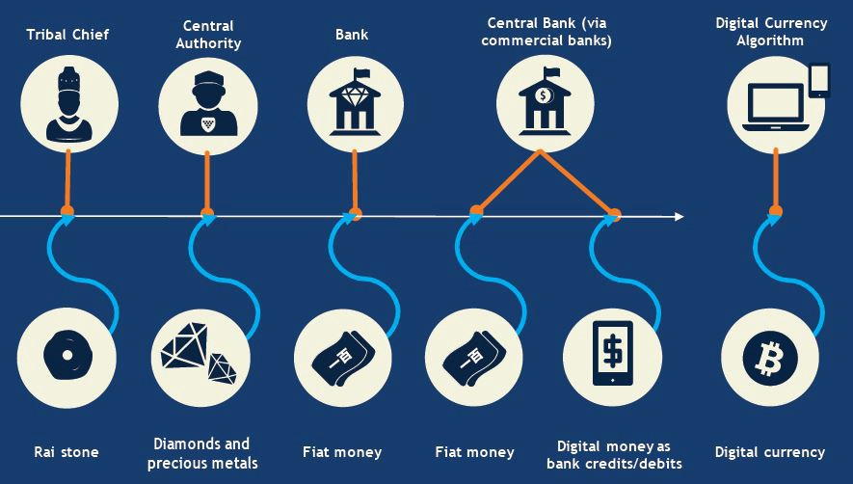
The promise of the blockchain
Notes:
Trusted Computing and Trustless Transactions
The concepts enable the spread of resources and transactions laterally, not only within an enterprise, but also across the entire participating membership of a blockchain-enabled system.
Centralized regulatory institutions and arbitrating organizations can be codified as smart contracts, governed by decentralized consensus on a blockchain. It is quite possible that, in the near future, new organizations will arise that are purely digital and driven by smart contracts. The blockchain will assert a role as an unequivocal validator of transactions, and thereby trust the blockchain ecosystem as a whole as a rule of trust, compliance, authority, governance and law are built on top of the technology, and are ensured using robust cryptographic methods.
Sources: Gartner, https://medium.com/mit-media-lab-digital-currency-initiative/blockchain-technology-redefining-trust-for-a-global-digital-economy-1dc869593308

Slide 17
Next step
understand blockchain's technology
extract business value blockchain technologies
integrate blockchain with enterprise systems
planning for changes that blockchain may require
Notes:
Understanding blockchain's technology evolution, opportunities, risks and key considerations
Determining how to extract business value from distributed ledgers, cryptocurrency tokens, smart contracts and other blockchain technologies
Preparing to integrate blockchain technologies with enterprise systems and other emerging technologies
Planning for any organizational, business, technological and cultural/societal changes that blockchain may require

Slide 18

Basics of the blockchain

Slide 19
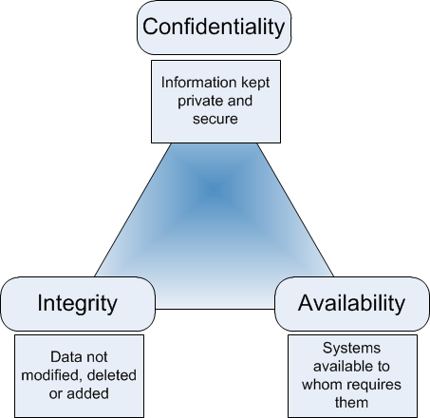
What is the blockchain about?
Decentralised, asynchronous processing
A logic to include/exclude participants
An algorithm to reach consensus
Immutability
Resilience
Transparency
Notes:
Decentralised, asynchronous processing (sometimes democratic)
A logic to include/exclude participants (may be open, private, hybrid, permissioned…)
Consensus is the process of agreeing on one result among a group of participants. E.g. avoiding double-spending on a cryptocurrency
Immutability (can’t be changed – integrity)
Resilience (hard to disrupt)
Transparency (at least within the environment) – no confidentiality (by default)
We will come back to the confidentiality point later more in depth as we explain the blockchain.

Slide 20
What are the design goals of the blockchain?
“Designed to Disintermediate and Disrupt”
Digital representation of value, privately issued
Varying levels of production/issuance and convertibility
Payment flows directly peer to peer, around established institutions
Design goal is to make central authorities irrelevant
DAO raised $200M in 3 weeks with crowdfunding, without banks, law firms, marketing or advertising

Slide 21
Blockchain Core Concepts
Mechanism for adding trust in an untrusted environment
Create and exchange multiple, various assets and forms of value
An irrevocable record of significant data and events, such as monetary transactions, property records or other valued assets
just a passive data record, or
optionally can add dynamically programmed behaviour to events
Transactions are sequentially grouped into blocks, validated (via consensus) and propagated across a network
Each block of transactions is chained to the previous and immutably recorded using cryptographic trust and assurance mechanisms
Depending on the type of distributed ledger, transactions can include programmability to enabled autonomous actions

Slide 22
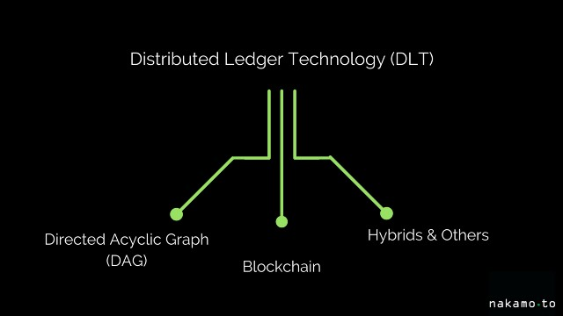
What is a DLT?
Distributed Ledger Technology (DLT) is the generic definition of an expanding list of cryptographically signed, irrevocable transactional records shared by all participants in a network
Synonym with blockchain – but not the same
Notes:
Source: https://medium.com/nakamo-to/whats-the-difference-between-blockchain-and-dlt-e4b9312c75dd

Slide 23
What exactly is a blockchain?
A linear Merkle tree (hash chain) implementing a distributed, “trustless” architecture incentivised by a value token
Value token
Money is an entry in a record (wallet)
Any system can issue tokens of value
Can be used for many other purposes, not just token issuing
Original Bitcoin whitepaper from Satoshi Nakamoto in 2008
Blockchain
Proof of Work
Consensus algorithm
Notes:
A linear Merkle tree which is used to implement a distributed, “trustless” architecture incentivised by a value token
Value token
Money is an entry in a record (wallet)
Any system which possesses database consistency to prevent double-spend and liveness to be responsive to transactions can issue tokens of value
Can be used for many other purposes, including general-purpose distributed trustless computing
Original Bitcoin whitepaper from Satoshi Nakamoto in 2008
Blockchain
Proof of Work
Consensus algorithm – practically, a large scale Bizantine Fault Tolerant algorithm resistant to up 1/2 corruption – simple, easy to deploy at large scale, reaches “eventual consensus”; transaction per seconds are very poor without additional enhancements.

Slide 24
Merkle Tree
Merkle Tree
Header
Hash Pointer
H
H
Hash Pointer
Hash Pointer
H
H
H
H
Data
Data
Data
Data
ID: 363110
© 2018 Gartner, Inc.
Notes:
Source: Gartner
Patented by Ralph Merkle in 1979.
A hash tree or Merkle tree is a tree in which every leaf node is labelled with the hash of a data block and every non-leaf node is labelled with the cryptographic hash of the labels of its child nodes. Hash trees allow efficient and secure verification of the contents of large data structures. Hash trees are a generalization of hash lists and hash chains.

Slide 25
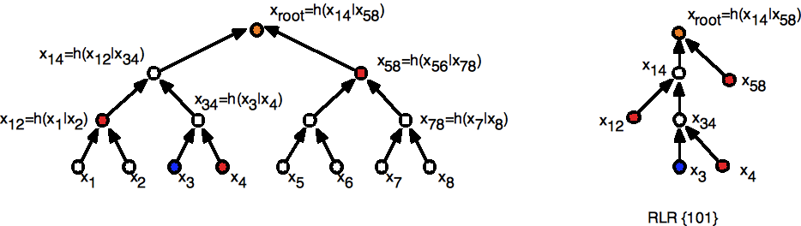
Hash tree vs linear Merkle tree
h(h(h(h(x)))) = h⁴(x)
Notes:
“A hash chain is a method to produce many one-time keys from a single key or password” (Wikipedia)

Slide 26
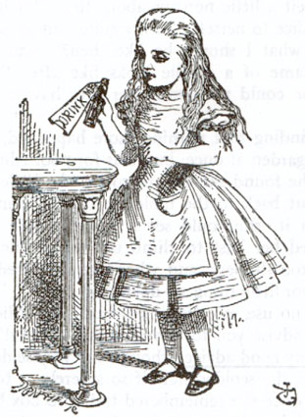


Password authentication with hash chains
h¹⁰⁰⁰ (password)
h⁹⁹⁹(password)
h¹⁰⁰⁰ (password) =
h(h⁹⁹⁹ (password))
h⁹⁹⁹ (password)
h⁹⁹⁸(password)
h⁹⁹⁸(password)
h⁹⁹⁹ (password) =
h(h⁹⁹⁸ (password))
h⁹⁹⁸ (password)
h⁹⁹⁸ (password) =
h(h⁹⁹⁸ (password))
h⁹⁹⁸(password)
F¹⁰⁰⁰(x), ..., F(F(F(x))), F(F(x)), F(x)
Notes:
Leslie Lamport, 1981 (http://merlot.usc.edu/cs530-s07/papers/Lamport81a.pdf) suggested the use of hash chains as a password protection scheme in an insecure environment.
A server which needs to provide authentication may store a hash chain rather than a plain text password and prevent theft of the password in transmission or theft from the server. For example, a server begins by storing h¹⁰⁰⁰(password) which is provided by the user. When the user wishes to authenticate, he supplies h⁹⁹⁹(password) to the server. The server computes h(h⁹⁹⁹(password)) = h¹⁰⁰⁰(password) and verifies this matches the hash chain it has stored. It then stores h⁹⁹⁹ (password) for the next time the user wishes to authenticate.
An eavesdropper seeing h⁹⁹⁹(password) communicated to the server will be unable to re-transmit the same hash chain to the server for authentication since the server now expects h⁹⁹⁸(password). Due to the one-way property of cryptographically secure hash functions, it is infeasible for the eavesdropper to reverse the hash function and obtain an earlier piece of the hash chain.
In this example, the user could authenticate 1000 times before the hash chain were exhausted. Each time the hash value is different, and thus cannot be duplicated by an attacker.
A hash chain is similar to a blockchain, as they both utilize a cryptographic hash function for creating a link between two nodes. However, a blockchain is generally intended to support distributed consensus around a public ledger (data), and incorporates a set of rules for encapsulation of data and associated data permissions.

Slide 27
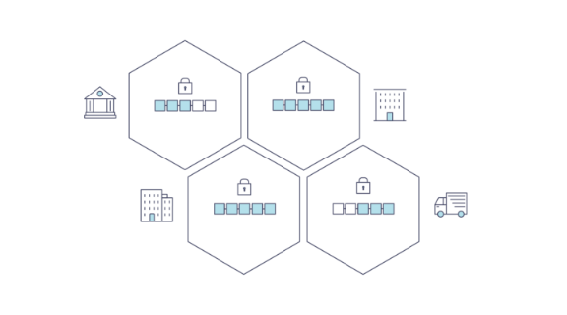
How does a blockchain ledger usually looks like
Distributed Ledger Technology (DLT)
Append only and peer-to-peer
Decentralised
Disintermediation
Collaborative
Consensus logic as a function
Data Repository / Database
“Eligible participant”: access policy
Example, Bitcoin: public
Private: requires cybersecurity
Headers are always available to all participants (transparency)
Requires awareness of the data stored – use CIA
Notes:
Source: Gartner, Hyperledger
The Blockchain (and Ancillary Blockchain Services)
At the heart of a blockchain network is the distributed ledger that records all the transactions that take place on the network.
It is important to state that the information recorded to a blockchain is append-only, using cryptographic techniques that guarantee that once a transaction has been added to the chain it cannot be modified. This property of “immutability” makes it simple to determine the provenance of information because participants can be sure information has not been changed after the fact. That’s why blockchains are sometimes described as systems of proof.
A blockchain ledger is often described as decentralized because it is replicated across many network participants.
The reference to the previous block contains a cryptographic hash checksum of the previous code, thus removing the need for a central intermediary. These methods also ensure that duplicate transaction records do not occur.
Each participant collaborates in its maintenance (as well as its integrity). Decentralization and collaboration are powerful attributes that mirror the way businesses exchange goods and services in the real world. The benefit of this architecture can be illustrated when dealing with the security of a dataset (such as device attribute or transaction data), by making evident any change or attempt to change the document and requiring consensus among the participants.
The consensus logic is separate from the application, and is a function of the blockchain platform. Applications can be written to take advantage of this decentralization, and security leaders can use them to ensure that the integrity of data across the participating member community is maintained.
The blockchain can also be viewed as a data repository, or a database, available to all eligible participants.
The notion of eligible participant may vary.
The bitcoin implementation of blockchain is designed so that all transaction data is public, especially since the eligible community is open to any willing participant. As blockchain technology matures, implementations may vary with respect to the membership of participants, as well as the rules and privacy with data. It is also important to note that, depending on use-case requirements, access control may be controlled based on policy, attributes or system design.
Private blockchain implementations may follow closed user community rules, which will likely require security leaders to implement network security measures to limit access in addition to managing cryptographic access keys.
While some specific implementations of blockchain may differ, security leaders must note that the architectural mode of the blockchain is to have header information available to all participants. This might also include the transaction records within the block. The data stored can be a token of value, such as a record of a financial transaction, an account balance or some other data, which can be encrypted using conventional cryptographic tools to provide confidentiality.
Due to the rapidly changing landscape with respect to blockchain offerings and technologies, chief information security officers (CISOs) and security leaders should ensure that they are aware of the data being created, stored and used with any blockchain-based initiative. This will differ, in some cases dramatically, depending on the blockchain technology (such as Ethereum, Hyperledger or bitcoin). While blockchain technology is exciting, fast-moving and poised to be highly disruptive, information security basics such as ensuring the use of the confidentiality, integrity and availability [CIA] model should still be exercised.

Slide 28
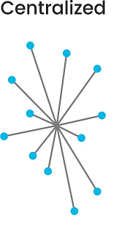
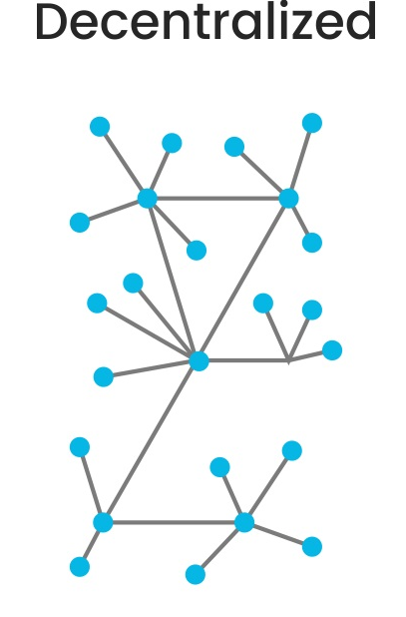
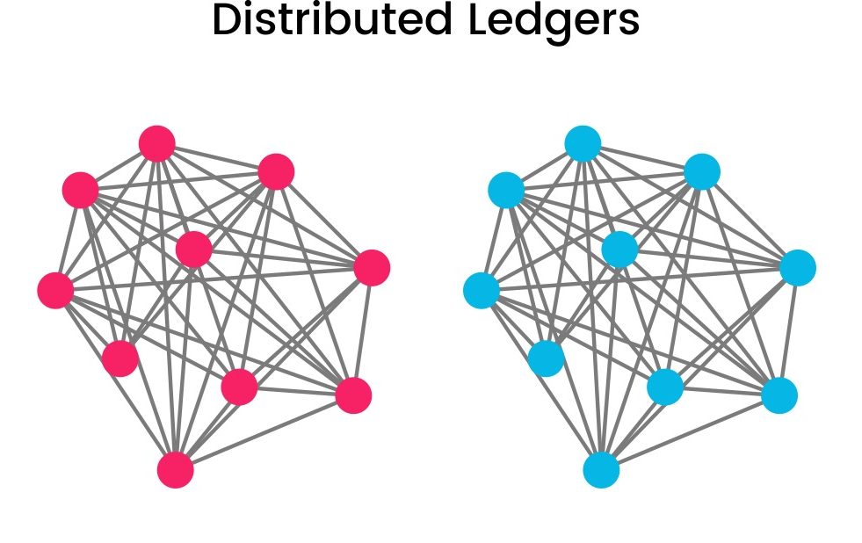
Consensus Distribution Models
On Distributed Ledger, there is no central authority
Peer-to-peer
Authority and trust are transferred to a decentralised virtual network called blockchain
Notes:
Sources: Gartner, Blockgeek
A traditional model uses a central arbiter to determine truth and measure accuracy (e.g., the integrity) of recorded data. An example of this is the traditional database that maintains consistency through centralized recording. In Centralized Systems there is one central authority or server and all the other nodes act like clients or entities who accept message and enact accordingly.
In Decentralized Systems there are multiple servers who receive messages from one central server. The individual nodes are connected to the secondary servers. However, in some systems, all servers can be of equal in hierarchy with no central server as well.
A Distribute Ledger transfers arbiter authority and trust to a decentralized virtual network, and enables eligible participating nodes to continuously and sequentially record transactions as a block of data, available to the members of the participating community. In Distributed systems there is no central authority. Each node is connected to every other node and has the exact same authority. Of course, in terms of computing distributed systems the processing power of each node might vary to a huge extent.

Slide 29
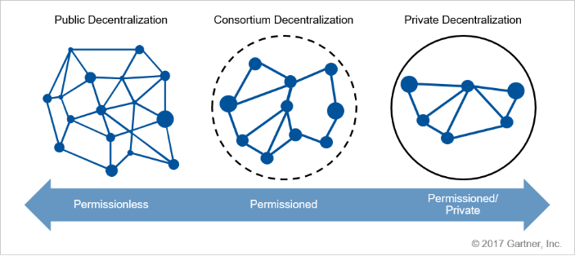
Public vs Private vs Consortium-based
Define the notion of “eligible participant”
Notes:
Source: Gartner
Consortium-based approaches appear to analysts to be gaining momentum due to their ability to leverage key beneficial characteristics of both permissioned and permissionless models.
Private blockchain implementations may follow closed user community rules, which will likely require security leaders to implement network security measures to limit access in addition to managing cryptographic access keys.
While some specific implementations of blockchain may differ, security leaders must note that the architectural mode of the blockchain is to have header information available to all participants. This might also include the transaction records within the block. The data stored can be a token of value, such as a record of a financial transaction, an account balance or some other data, which can be encrypted using conventional cryptographic tools to provide confidentiality.
Due to the rapidly changing landscape with respect to blockchain offerings and technologies, security leaders should ensure that they are aware of the data being created, stored and used with any blockchain-based initiative.
This will differ, in some cases dramatically, depending on the blockchain technology (such as Ethereum, Hyperledger or bitcoin). While blockchain technology is exciting, fast-moving and poised to be highly disruptive, information security basics such as ensuring the use of the confidentiality, integrity and availability [CIA] model should still be exercised.

Slide 30

Surviving your company’s Blockchain initiative
Notes:
Source: https://hbr.org/2016/08/how-to-survive-a-company-scandal-you-had-nothing-to-do-with

Slide 31
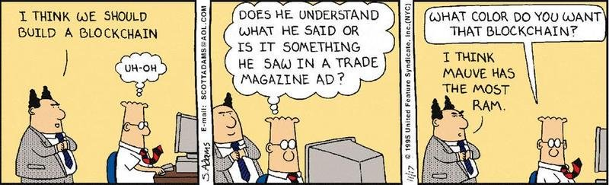
FAKE! …but still…
Notes:
Esoteric technology topics that would previously have been off-the-table for non-technologists (e.g., cryptography zk-SNARKs or consensus mechanisms like Byzantine Altruistic Rational consensus) are now being mentioned by business leaders.
There is greater focus on the technological disruption of business models and even industries.
There is an increased proliferation of technological supply away from traditional core suppliers.
Skill fragmentation is a benefit and a curse.
Knowledge of risk-adjusted returns, and especially customer adoption behaviours and proclivities, is now an IT requirement.

Slide 32

Make sense of the blockchain
Blockchain can be viewed as a protocol
It must support real, needed business process, like HTTP supports e-commerce
Verify that blockchain makes sense for the initiative
Ensure that implementing blockchain produces new digital business that cannot be realized in other ways
Perform the Ground Work from the next slides
Perform the Risk Assessment as explained later
Notes:
Blockchains can be viewed as a protocol. It must support real, needed business process, like HTTP supports e-commerce
As such, they must support an existing or needed business process, in the same way that the HTTP protocol supports e-commerce. Making sure that using blockchain makes sense for the business is the first priority (for example, if you're using a blockchain for the sake of saying you have it, it's probably a mistake).
More importantly, ensure that the implementation of blockchain technology enhances or creates a new digital business initiative that otherwise could not be realized.

Slide 33
Ground work
Blockchain technology are immature from a technology perspective
There are too many platforms to actively track and understand
Because of difficulty in grasping the differences, organisations tend to focus on consortium-based approaches
Blockchain is still subject to cyber threats – requires crypto-agility
What you should do:
engage with the blockchain initiatives, inform and advise of the risks
don’t trust vendors – and prophets
be aware of the data created, stored and used
leverage the old fashioned CIA model
eventually apply data-centric security (encryption)
Notes:
While a wide variety of early proofs of concept (PoCs) are underway, blockchain technology and its applications remain nascent and immature from a technology perspective.
Gartner is tracking over 75 blockchain platforms. Security and risk management (SRM) leaders cite that there are too many, all with a variety of models and offerings, to actively track and understand.
Decentralization and trust control models, such as public, private and consortium approaches, often confuse SRM leaders. Outside of crypto-currencies, public blockchains remain a challenge to create. Therefore, SRM leaders tend to focus on consortium-based approaches.
While blockchain relies on cryptography for basic security, it is still subject to cyber threats and therefore requires crypto-agility
Security and risk management leaders tasked with improving application and data security should:
Actively engage with their organizations' blockchain-based initiatives by engaging with relevant business leaders, to inform and advise on the risks, benefits and limitations of this emerging technology.
Be cautious of overoptimistic vendor claims by evaluating the technical security aspects of blockchain platforms under consideration.
While some specific implementations of blockchain may differ, security leaders must note that the architectural mode of the blockchain is to have header information available to all participants. This might also include the transaction records within the block. The data stored can be a token of value, such as a record of a financial transaction, an account balance or some other data, which can be encrypted using conventional cryptographic tools to provide confidentiality.
Due to the rapidly changing landscape with respect to blockchain offerings and technologies, security leaders should ensure that they are aware of the data being created, stored and used with any blockchain-based initiative. This will differ, in some cases dramatically, depending on the blockchain technology (such as Ethereum, Hyperledger or bitcoin).
While blockchain technology is exciting, fast-moving and poised to be highly disruptive, information security basics such as ensuring the use of the confidentiality, integrity and availability [CIA] model should still be exercised.
Ensure the confidentiality of blockchain-enabled applications by leveraging a variety of data-centric security approaches (such as encryption) while taking advantage of the integrity and availability benefits.

Slide 34
Other things necessary
Readiness assessment: are processes ready for decentralization?
If processes are designed for a centralized model, traditional components will be more suitable
decentralizing processes is the real way
Select an architecture strategy
Compare candidate platform
Strategy should be kept flexible
immature
lack standards
lack deployment best-practices
May need readjustment in little time
Notes:
Technical professionals focused on blockchain-enabled solutions should:
Perform a readiness assessment to make processes suitable for decentralization or shared ledgers.
Applying blockchain to processes designed for a centralized business model moves requirements toward platforms that use traditional components.
Decentralization of processes can tip the choice toward platforms that use truly decentralized components.
Select an appropriate architecture strategy and compare candidate platforms. The strategy should remain flexible because blockchain platforms are immature, and lack standards and well-established deployment best practices. The rapid pace of blockchain technology evolution may require adjustments in the target architecture.

Slide 35
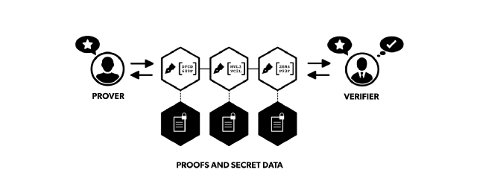
Adoption Challenges
Very few projects are production-ready in an enterprise setting
Regulatory challenges waiting at the horizon
In payment use cases, price volatility
Many PoCs are about permissioned blockchains
it is not feasible for a company to join multiple private blockchains from all their partners
the unique option is zero-knowledge proof
Notes:
Even though we see exploration and experimentation across all industries, a couple of major challenges still remain to get DLT adoption off the ground.
First, there is the maturity of the technology. Only few projects are close to being production-ready in an enterprise setting, especially Ethereum with the efforts coming out of the Ethereum Enterprise Alliance is making good progress, but all are still untested for large-scale commercial implementation.
There are challenges around adoption itself. There is still a lot of regulatory risk that might put invested efforts in jeopardy. And since most adoption scenarios would require all involved parties to be convinced to participate to achieve the full benefit, people are effectively dependent of the last adopters within a value network.
The price volatility is a big challenge in payment use cases. The number of options to mitigate it are increasing, e.g. using futures to hedge, or using a so-called stablecoin which have fiat-currency-pegged conversion rates. Still, it either limits use cases or creates additional efforts that might deteriorate a business case.
And last, there’s a self-made problem of many industry-led initiatives from betting too much on private (permissioned) blockchain solutions. This approach might seem obvious at first considering the need for privacy of business data vs. that data on public ledgers would be visible to everyone. The flip side however is that you would expect that every business partner joins every private blockchain of every business partner out there. And even if that would be feasible, these private networks are even more prone to misuse of trust as they are typically not Byzantine fault tolerant. Maybe privacy-based solutions (e.g. zero-knowledge proof) will offer a way out of the dilemma.
Sources: http://people.csail.mit.edu/silvio/Selected%20Scientific%20Papers/Proof%20Systems/The_Knowledge_Complexity_Of_Interactive_Proof_Systems.pdf
https://medium.com/@argongroup/on-zero-knowledge-proofs-in-blockchains-14c48cfd1dd1

Slide 36
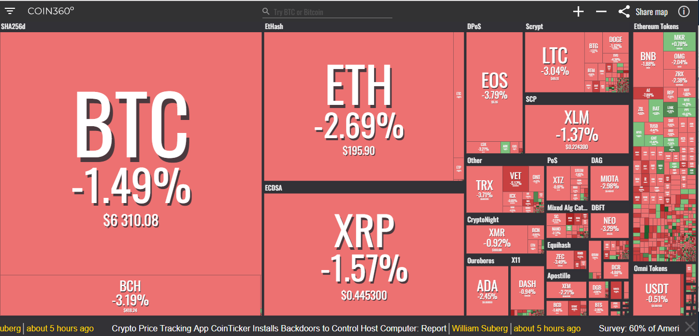
Volatility
Notes:
Source: coin360.io

Slide 37
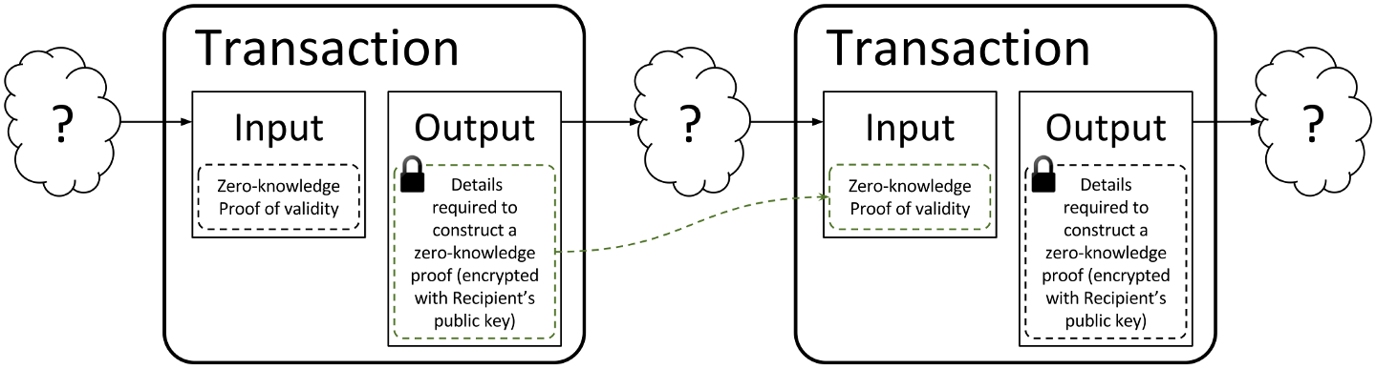
Privacy-preserving blockchains
zk-Snarks – Zero-knowledge protocols enable the transfer of assets across a blockchain network with complete privacy
Other participants only know that a valid transaction has taken place
First notable implementer was ZCash, then Ethereum
Problem: it is still too computationally expensive
Notes:
The term was introduced in 2012 by Nir Bitansky, Ran Canetti, Alessandro Chiesa & Eran Tromer and describes a special variation of the zero-knowledge technique. zk-SNARKs introduce a number of innovations that render them usable in blockchains. Most importantly, zk-SNARKs reduce the size of the proofs and the computational effort required to verify them.
Zero-knowledge protocols enable the transfer of assets across a distributed, peer-to-peer blockchain network with complete privacy. In regular blockchain transactions, when an asset is sent from one party to another, the details of that transaction are visible to every other party in the network. By contrast, in a zero knowledge transaction, the others only know that a valid transaction has taken place, but nothing about the sender, recipient, asset class and quantity. The identity and amount being spent can remain hidden, and problems such as “front-running” can be avoided.
The most prominent blockchain-based system using zero-knowledge proofs is ZCash, which was also the first cryptocurrency to implement zk-SNARKs. Other blockchain-based systems have since also incorporate zero-knowledge proofs into their solutions to allow for transactions to be verified while protecting user/transaction privacy. Probably the best known of which is Ethereum, which implemented zk-SNARKS as part of the Byzantium upgrade.
Source: https://medium.com/@argongroup/on-zero-knowledge-proofs-in-blockchains-14c48cfd1dd1
https://dl.acm.org/citation.cfm?id=2090263
https://z.cash/technology/zksnarks.html
https://cointelegraph.com/news/ethereum-upgrade-byzantium-is-live-verifies-first-zk-snark-proof

Slide 38
Possible timeline
First week
Clarify how your organization understands blockchain technology… and educate management
Conduct internal IT meeting to assess opportunities for development using a blockchain technologies – e.g., in security, open platforms, etc.
Next 90 Days
Conduct an assessment of your internal capabilities
Assess vendors talking about blockchain and analyse their capabilities
Select a limited and simple narrow-scope use case for real deployment
Next 12 Months
Assess whether users are enabled to everyday use, fit for business and consumer context.
Notes:
First week
Clarify how your organization understands blockchain technology… and educate management
Conduct internal IT meeting to assess opportunities for development using a blockchain technologies. E.g., in security, standards, open platforms etc.
Next 90 Days:
Conduct an assessment of your internal capabilities for developing, deploying and maintaining a blockchain initiative.
Assess which vendors are talking to you about blockchain technology and "carefully" analyse their capabilities.
Selecta limited and simple narrow-scope use case for real deployment on a chosen platform.
(Use internal blockchain washing to fund legacy modernization projects.)
Next 12 Months:
Assess whether the users of any initiative have sufficient technological knowledge and access to enable everyday use, fit for business and consumer context.

Slide 39
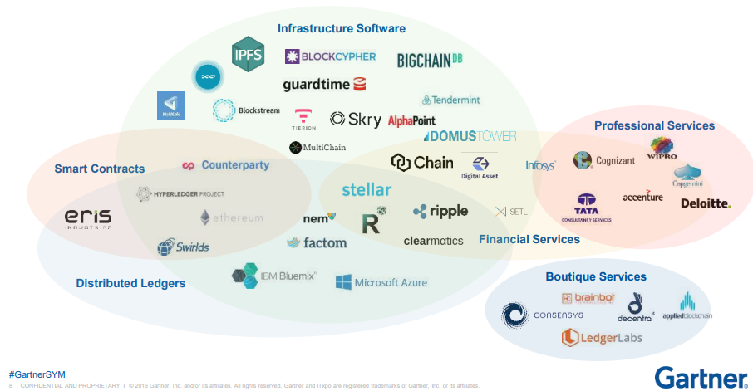
Vendors’ Panorama
Notes:
Source: Gartner

Slide 40
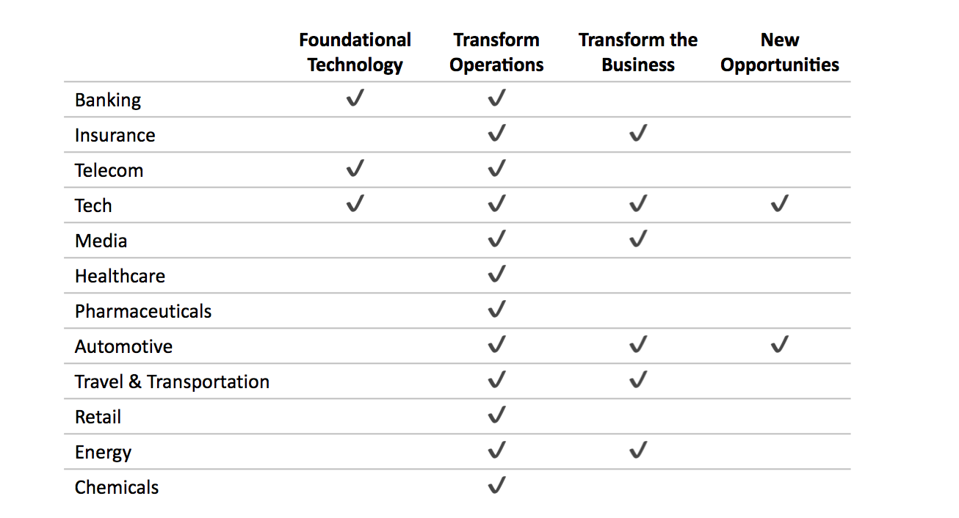
Snapshot of current known PoCs
Notes:
Banking might the industry that’s closest to being production-ready, moving from small niche solutions and pilots to larger adoption step by step. Even though there doesn’t seem to be anything in production yet, there are many examples of pilots especially around payments and trading. Some 100 institutions signed up to pilot RippleNet for international payments. A couple of European banks founded We-Trade, a joint venture to develop a trade platform for commercial clients. JPMorgan has an internal blockchain team that developed its Ethereum-based in-house blockchain solution Quorum, in which it incorporated ZCash’s privacy technology. ING developed a similar solution for private blockchain transactions. Bank of America is exploring opportunities for data sharing, RBC is experimenting with international payments, BBVA on FX matching, and BNP Paribas on dividend payments and stock splits. Of the credit card companies, Visa is piloting a B2B payments service and MasterCard a system for instant payment processing.
Within the Insurance industry, French insurance company AXA might be furthest ahead with a first live product; it has launched a new flight delay insurance product that uses the public Ethereum blockchain to store and process payouts. Across the industry, several pilots & trials are being conducted, mostly around payment and workflow improvements. ANZ is building a blockchain-based platform to ease the transfer of data and premium payments between brokers and insurers together with IBM. Allianz has been testing an internal token for money transfers between its global affiliates to avoid having to deal with currency conversions, and announced a solution for car loan refinancing. And they developed a prototype for a more streamlined approach for captive or self-insurance policies. Insurance broker Marsh is working with IBM to develop a blockchain-based insurance verification platform. And a group of 9 Chinese insurance companies completed a trial of an insurance asset trading platform.
The Telecom industry is approaching DLT from multiple angles. They are developing and patenting core technology elements, e.g. AT&T for digital currency payments for connected cars, Comcast for distributed storing of user data, and British Telecom for cybersecurity measures to protect blockchain networks. Comcast, Orange, and Verizon are conducting venture investments in DLT startups. And they are pursuing modest to more ambitious goals. British Telecom, Telefonica, and Telstra are trialing the settlement of wholesale international services. Swisscom has created a new business entity centered around blockchain. And Korea Telecom has plans to rebuild South Korea’s network infrastructure based on blockchain.
Tech companies have primarily been focusing on obtaining blockchain-related patents, started launching blockchain-as-a-service offerings (e.g. Microsoft, Amazon, IBM, Oracle), and exploring enterprise solutions, especially around supply chain tracking and IOT. Microsoft also has a security-focused service for government use, and works on supply chain tracking and identity management solutions. Amazon collected a few patents, e.g. for cloud computing, and a streaming data marketplace, and offers R3 Corda hosting services. IBM collaborates with clients to pursue use cases such as supply chain tracking, payments, medical data exchange. Oracle got some patents, e.g. for workflow improvements and governance. Accenture also got some patents, e.g. around security and editing out of their blockchain R&D unit, and did a trial for a digital traveler identity solution. Google hasn’t done much publicly yet, apart from a patent applications around audit data security. Cisco is collecting patents around e.g. mining, collaboration, and IOT device tracking. Bosch partners with IOTA to develop IOT-related use cases, Samsung and SAP explore solutions to manage Supply Chain and Intel for digital rights management.
Media companies haven’t done much yet, with some limited activities on use cases around advertisement and content management. Comcast launched an advertising platform partnering with e.g. Disney, NBC Universal, and Channel 4. Canadian Groupe Média TFO trials solutions to track copyrights. Spotify acquired a startup working on a content metadata solution. And Facebook just set up a team to explore blockchain use cases.
Among Healthcare payers and providers, there are only a few pilots trying to improve administrative processes so far. Humana, MultiPlan, Quest Diagnostics, Optum, and United Healthcare are running a pilot to improve admin data management, and Capital One is testing a solution for health care claims management.
Within the Pharmaceuticals industry, companies are trying out blockchain solutions in core parts of their value chain, particularly in clinical research and for supply chain tracking. Merck & Co is exploring its application for clinical trials and electronic health records. Pfizer, Amgen, and Sanofi investigating use cases in clinical research as well. A working group comprising Roche, Pfizer, AmerisourceBergen, and McKesson are exploring how they can improve supply chain security.
Automotive companies are quite ambitious in their exploration of DLT, trialing both efficiency use cases as well as exploring it to innovate their business models. Volkswagen, BMW, and Renault all conducted trials with tracking of vehicle data telematics tracking to prevent tampering when the car is resold. Daimler conducted a test to issue a corporate bond issuance. Toyota ran a trial on a data marketplace for autonomous vehicle driving data and for a car sharing platform. Ford got a patent for car-to-car transactions to manage traffic. And also Volkswagen seems to have ambitious yet unspecific plans using DLT in the shift to autonomous vehicles.
In the Travel & Transportation industry, there’s a clear focus on using DLT to improve tracking and collaboration, even though Lufthansa is also testing a travel app platform for customer-facing solutions. Airbus has conducted a proof-of-concept for plane parts tracking. Air France is exploring supply chain and workflows tracking solutions for aircraft maintenance. TUI is using DLT to track internal contracts, and is working on a shared record of hotel inventories. Maersk and SK Group have both done trials to track the movement of shipping cargo. FedEx is testing a solution to track deliveries. And to Port of Rotterdam uses DLT to share logistical and contractual data.
Retail companies are very much focused on supply chain tracking in their trials so far. Walmart wants to track origins and movements of food. Alibaba tests products tracking to fight counterfeiting. De Beers is looking into a diamond tracking platform to avoid conflict diamonds. And JD.com explores supply chain tracking, too.
The Energy sector has seen some exploration of use cases but with limited impact yet. BP, Shell, Statoil, and Vatten fall among others started to explore an use case around an energy trading platform, and at least BP seems to be exploring use cases beyond that. Wien Energie is exploring different use cases around e.g. electric car charging stations, land registry, and power supply. And the Chilean National Energy Commission experiments with tracking of energy data on the Ethereum blockchain.
In the Chemicals industry, only BASF seems to have started any activities; they conducted a trial for supply chain tracking.

Slide 41
Blockchain as a Service
BaaS as an emerging possibility for the supporting infrastructure
Similar to a “cloud” offering
Economies of scale
Elasticity
Expertise
Security + standards
Main providers
IBM (Hyperledger Sawtooth Lake – Bitcoin)
Microsoft (Coco Framework – Ethereum)
AWS (Ethereum Network)
Private and Permissioned
Current BaaS focus: “safe” experimentation
Notes:
Source: University of Cambridge

Slide 42
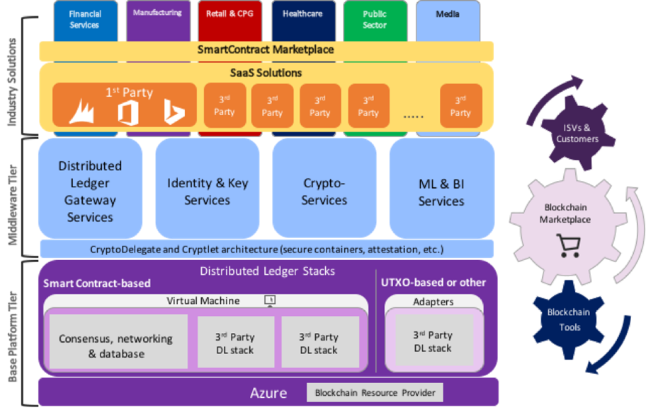
Microsoft’s Project Bletchley
Notes:
Example from MS – ledger components down the bottom, integration/management services higher
Aspects might be configured (or integrated). Apps from the top-down

Slide 43
Architectures
BaaS
Provider
Organization A
Organization B
Organization C

Slide 44
Key Considerations
The provider is the tenant of the Smart Contract
The tenant owner pays for running them
Trusted execution environment (enclaves)
Function as ledger mediator for multiple parties
Who controls what still depends on the organizational structure and the system architecture
Consortium or Federation?
More secure?
Depends on the risk profile and how much can participants see
Risk and Security themes overlap with “trusted cloud”

Slide 45
Legal and Regulatory Challenges
Jurisdiction – challenged by the concept of decentralization
Service levels and performance – vendors are unable to offer warranties
Liability – especially in trading platform like cryptocurrencies
Intellectual Property – vendors will likely try to capitalize on this
Data Privacy – not alterability of data and transparency
DAOs – legal status unclear
Smart Contracts enforceability
Compliance with financial services regulation (where applicable)
Exit assistance
Common Law’s concept of “property”
Due diligence is yet to be clearly defined
Notes:
Jurisdiction
Blockchain has the ability to cross jurisdictional boundaries as the nodes on a blockchain can be located anywhere in the world. This can pose a number of complex jurisdictional issues which require careful consideration in relation to the relevant contractual relationships.
The principles of contract and title differ across jurisdictions and therefore identifying the appropriate governing law is essential. In a conventional banking transaction, for example, if the bank is at fault then irrespective of the transacting mechanism or location, the bank can be sued and the applicable jurisdiction will most likely be contractually governed. However, in a decentralised environment, it may be difficult to identify the appropriate set of rules to apply.
At its simplest level, every transaction could potentially fall under the jurisdiction(s) of the location of each and every node in the network. Clearly, this could result in the blockchain needing to be compliant with an unwieldy number of legal and regulatory regimes. In the event a fraudulent or erroneous transaction is made, pinpointing its location within the blockchain could be challenging.
The inclusion of an exclusive governing law and jurisdiction clause is therefore essential and should ensure that a customer has legal certainty as to the law to be applied to determine the rights and obligations of the parties to the agreement and which courts will handle any disputes.
Service levels and performance
The willingness of vendors to commit to performance assurances is likely to depend on three considerations: (i) their risk/reward profile; (ii) the service delivery model and (iii) the “multiplication factor” of accepting significant liability for multiple customers – on a “one to many” approach – at the same time. This is likely to mean vendors preferring to offer the technology and service on an almost “as is” basis, with a limited availability service level, and excluding warranties regarding performance of the services, leaving customers without any assurance that the technology will function as described or the service be reliable and available. However for users who are utilising the service as part of their business, this is unlikely to be an acceptable proposal. The balance of performance risk will therefore be a key issue.
Liability
The risk to customers of a systemic issue with trading related infrastructure such as blockchain could be material if trades are not settled or are settled incorrectly. Likewise the risk relating to security and confidentiality will be towards the top of the risk issues of any prospective customer.
Blockchain poses different risks as a consequence of the technology and manner of operations: one of the main issues affecting public blockchain is the inability to control and stop its functioning. In case of a private blockchain, the lack of control on the functioning of the platform does not apply but whether or not this would be sufficient to trigger a liability of the company managing the platform has not yet been tested.
So the allocation and attribution of risk and liability in relation to a malfunctioning blockchain service must be thought through carefully, not just at the vendor-customer level, but as between all relevant participants, in particular the parties (perhaps counter-parties for a trade) affected by the issues.
Intellectual property
There is inevitably value in the blockchain, and ownership of the IP in it will likely form an important consideration albeit that the limitations on the patentability of software and business processes (in the UK at least will erode some of the relevant issues). However, given the amount of investment and the potential financial returns of blockchain technology, blockchain vendors will have to determine their IP strategy: vendors will likely want to capitalize on any other commercial benefits to be generated from the Blockchain, including commercialization of the underlying data set. To the extent the data set relates to the users, this is likely to be a carefully negotiated area.
Likewise, what of specific developments or solutions which overlay the core, developed to meet a customer’s specific requirements? Possible IP options are no different to any other software development agreement and are likely to hinge on whether those specific requirements could give a customer a competitive edge and/or can be used by the blockchain vendor with another customer or by the customer with another blockchain vendor. Depending on the answer to these questions, a customer may insist on ownership of such developments, may be willing to ‘merely’ license them for the term of the agreement (or perpetually if usable with other networks) or restrict the vendor’s ability to use such developments in some way, whether time, use or recipient based or a combination of all three.
An “open innovation” approach is prevalent throughout fintech. Financial organisations are working towards a viable blockchain proof of concept and are developing a lot of code in-house. Traditionally financial organisations have expected to own the IP in any software that they develop. However there appears to be a realisation that technology will have to be shared in order for value to be gained.
Data privacy
As one of the key USPs of the blockchain is that once data is stored it cannot be altered (at least, not easily), this clearly has implications for data privacy, particularly where the relevant data is personal data or metadata sufficient to reveal someone’s personal details. Equally the unique transparency of transactions on the blockchain is not easily compatible with the privacy needs of the banking sector: the use of crypto-addresses for identity is problematic as no bank likes providing its competitors with precise information about its transactions and the banking secrecy must be kept by law.
In order to prevent this becoming a barrier to take-up, technology-based solutions will need to be found to design privacy-protecting blockchains. This might include limiting who can join the blockchain network to “trusted” nodes and encrypting the data on the blockchain, although this is not without its challenges, and it remains to be seen how vendors, particularly those targeting the financial services industry, tackle the balance of privacy versus transparency.
Decentralised Autonomous Organisations (DAOs)
DAOs are essentially online, digital entities that operate through the implementation of pre-coded rules. These entities often need minimal to zero input into their operation and they are used to execute smart contracts, recording activity on the blockchain.
Modern legal systems are designed to allow organisations, as well as actual people, to participate. Most legal systems do this by giving organisations some of the legal powers that real people have – e.g. the power to enter into legal contracts, to sue, and to be sued. But what legal status will attach to a DAO? Are they simple corporations, partnerships, legal entities, legal contracts or something else?
Since the DAOs “management” is conducted automatically, legal systems would have to decide who is responsible if laws are broken. What, if, any, is the liability of DAOs and their creators? Who or what is claimed against in the case of a legal dispute?
Courts and regulators are unlikely to allow the wholesale adoption of technology which bypasses established oversight.
The enforceability of smart contracts
Blockchain makes possible the use of so-called “smart contracts”. Smart contracts are blockchain based contracts which are automatically executed upon certain specified criteria coded into the contract being met. Execution over the blockchain network eliminates the need for intermediary parties to confirm the transaction, leading to self-executing contractual provisions. In addition to the cost and efficiency gains it is hoped this will achieve, this also raises significant legal questions in relation to applicable regulation, leaving a sense of uncertainty as to the legal enforceability of smart contracts.
Since smart contracts are prewritten computer codes, their use may present enforceability questions if attempting to analyse them within the traditional ‘contract’ definition. This is particularly true where smart contracts are built on permissionless blockchains, which do not allow for a central controlling authority. Since the point of such blockchains is to decentralize authority, they might not provision for an arbitrator to resolve any disputes that arise over a contract that is executed automatically. It remains unclear whether the elements of capacity, including the ability to rely on apparent or ostensible authority would apply and the questions of offer and acceptance, certainty and consideration would also need to be considered. However, there have been advances in many countries regarding the level of acceptability of electronic contracts so it is realistic to hope this is carried over to smart contracts. In the meantime, customers should ensure that smart contracts include a dispute resolution provision to reduce uncertainty and provide for a mechanism in the event of a dispute.
Compliance with financial services regulation
Many sourcing arrangements, including the use of certain technology solutions, require regulated entities to include in the relevant contracts a series of provisions enabling them to exert control, and seek to achieve operational continuity in relation to the services to which the contracts relate. With blockchain (as has been the case with cloud and certain FinTech agreements) this may well be more of a challenge. The contracts and overall arrangement will need to be carefully reviewed to ensure compliance, as required. For in-depth analysis of the current state of the regulatory landscape, please see our publication “The Blockchain revolution: an analysis of regulation and technology related to distributed ledger technologies.”
Exit
The need for exit assistance will be determined in large part by the specific solution and the extent to which the blockchain vendor holds the customer’s data. If the customer does not have its own copy of the data, it will require data migration assistance to ensure the vendor is obliged to hand over all such data on expiry or termination of the agreement and a complete record of all transactions stored on the blockchain.
Is data on a blockchain “property”?
At common law as a general principle there is no property right in information itself, but that while individual items of information do not attract property rights, compilations of data – for example in a database – may be protected by intellectual property rights. Where a database of personal information is sold, if a buyer wants to use the personal information for a new purpose, in order to comply with the Data Protection Act they will have to get consent for this from the individuals concerned.
Due diligence on blockchain
Public companies and private investors have already begun to make significant capital investments in blockchain technology startups. This trend is likely to accelerate as commercial deployments of blockchain technology become a reality. Transactional lawyers who are tasked with performing due diligence on the buy and/or sell side in connection with these investments need to understand blockchain technology and the emerging business models based on the technology. Traditional due diligence approaches may need to be adapted. For example, there will be unique issues concerning ownership of data residing on decentralised ledgers and intellectual property ownership of blockchain-as-a-service offerings operating on open source blockchain technology platforms. These issues will need to be considered in the context of the business value proposition and competitive barriers to entry.
Source: https://www.dlapiper.com/en/denmark/insights/publications/2017/06/blockchain-background-challenges-legal-issues/

Slide 46
Phase 1: Business Processes
What specific features unique to blockchain do we need for this project?
What is the lifetime of this project and its resulting business applications, and will we be able to support the business and technical requirements?
What impact will the blockchain aspects of this project and its associated application have on how end users interact with the system?
What would be the impact to the project if parts of the blockchain were locked due to human or technology error, such as loss of control of private keys?
What additional skills will be required to support a blockchain-based project and resulting application?

Slide 47
Phase 2: the Trust Model
What are the relevant advantages or disadvantages of public versus private or consortia blockchain for this project? What risks do each model pose, and who would own those risks?
What are the organizations that will be involved, and what is the trust model for them?
What is the governance model (trust framework) for participating organizations and their members?
How are responsibilities for the blockchain distributed?
The choice of trust model can affect the initiative outcome.
Notes:
Once you decide that blockchain can help solve your problem, one of the first decisions you need to make is whether you need a public blockchain where anyone can join, or a private one, where only select members can participate.
The public model allows for self-certifying participants to join or quit at will and has decentralized trust with no central identity management.
Private blockchains are closed groups that support models with centralized identity and membership requirements, making overall control much easier, but limiting participation. Further, many blockchains operate within a business context that includes several other groups or organizations, which form a consortia.
Blockchain platforms' underlying design and functional components highly influence its ability to deliver collective versus granular trust control. The choice of trust model and underlying platform can affect the initiative outcome. Therefore, the comparison of platforms requires a normalized functional framework to select technologies that better match the business requirements.

Slide 48
Phase 3: Business Logic and Execution/Resiliency
What is the business life cycle for blockchain participants?
What is the expected frequency of change to the business logic (application) and supporting infrastructure?
What is the business logic for joiners, movers and leavers?
Who issues credentials, and how are they managed?
What plain-text data will be captured in each block?
Notes:
This is dependent on the choices above, and decisions start to transition from business issues to more technical and identity-centric ones. Matching the business logic of the problem to the correct IAM, public-key infrastructure (PKI) provisioning and/or identity fabric is crucial and will greatly impact the success of the project. A heavy emphasis should be placed on testing both code and business processes and agreements. Consider issues for application testing, smart contract testing, blockchain conflict resolution and changes in the consortia or governance. Also plan for private-key compromise, identity life cycle management, key rolling and crypto-agility.

Slide 49
Phase 4: Risk Management and Compliance
What are the relevant regulatory issues for the project?
What are the options for meeting them within the blockchain protocol?
What data will be carried in plain text by the blockchain?
Who in the organization or consortia will regulators look to for answers?
Notes:
At a recent Gartner blockchain workshop, a participant noted, "It's not the blockchain protocol that gets you into trouble with GDPR [the General Data Protection Regulation], it's the data in the payload of the block." Like the HTTP protocol, blockchain is flexible and adaptable, but contains no inherent tools for meeting various compliance or privacy needs. While blockchain does use encryption for integrity and time-stamping, payloads are usually in plain text and can be read by everyone who has access to the blockchain. You will need to map out the risks and compliance strategy explicitly.

Slide 50
Phase 5: Identity and Key Management
What is the full life cycle of the keys that blockchain participants will use for the project?
How are the details of identity managed?
Are block payloads encrypted?
For identities, are privacy-preserving methods needed for anonymity?
How are keys managed and revoked?
What mechanism will be used to protect private keys?
What will be the approach to problems such as crypto-agility and identity theft?
Notes:
Here we begin to move into the technical aspects of the blockchain. First is the usual identity management, PKI and key management concerns: creating, issuing, managing and revoking credentials, credential replacement, identity confirmation and vetting, fraud, and so on. While PKIs have been around for decades, the use of certificates in the blockchain poses some unique challenges. For example, if a user's private key is lost or stolen, it could potentially lock them out of the blockchain permanently unless you have prepared ahead of time with procedures for transferring identities. In private blockchains, this is easier than it is for public ones, where there is no central authority and fraud is a significant risk. Plan for all the possible identity end states ahead of time, before your team writes any code!

Slide 51
Phase 6: Threat/Network/Node Management
What is the logic for resolving blockchain block collisions?
How do you keep track of distribution nodes in the system, and what would a critical fault event look like?
What is the disaster recovery plan for your blockchain participants?
How to deal with out-of-context problems, like net neutrality, or with older networks that may introduce lags?
Are there any race conditions in the distribution of nodes that would allow a person or small group to control the blockchain?
Notes:
Blockchains depend on networks — yours and others — and on client software. Both have long histories of compromises, security events and human error, so it makes sense to look at the network layer and plan how to recover when things go wrong. Public blockchains are a little more exposed, but the same types of problems will turn up in privately managed blockchains. Also, you will need to determine how to resolve conflicts in your blockchain (for example, if two blocks attempt to be appended at the same time, how do you resolve which one wins)?
You may have timing issues or race conditions, which can be problematic or even exploited if you don't put enough thought into how to resolve network outage issues. For example, in a consortia-led private blockchain, could the group stop a malicious controller from manipulating the centralized network? How would such an attack be detected? Who would bear financial liability?

Slide 52
Phase 7: Physical Layer Management
What is the minimal security posture for blockchain clients or wallets for participation in the projects?
How do physical processes get conducted through smart contracts or blockchain instructions?
Notes:
Finally, what are the requirements for your blockchain participants in terms of hardware? Private keys can be managed both in software and on smartcards, but both require a degree of maintenance and protection to keep the keys safe. This is in addition to the issues above around network/disaster recovery management. Also, if your blockchain project involves physical goods, such as money or freight, understanding how to translate blockchain or smart contract events into physical processes will be fundamental to your success.
Key questions about physical layer management in blockchain:
What is the minimal security posture for blockchain clients or wallets for participation in the projects?
How do physical processes get conducted through smart contracts or blockchain instructions?

Slide 53
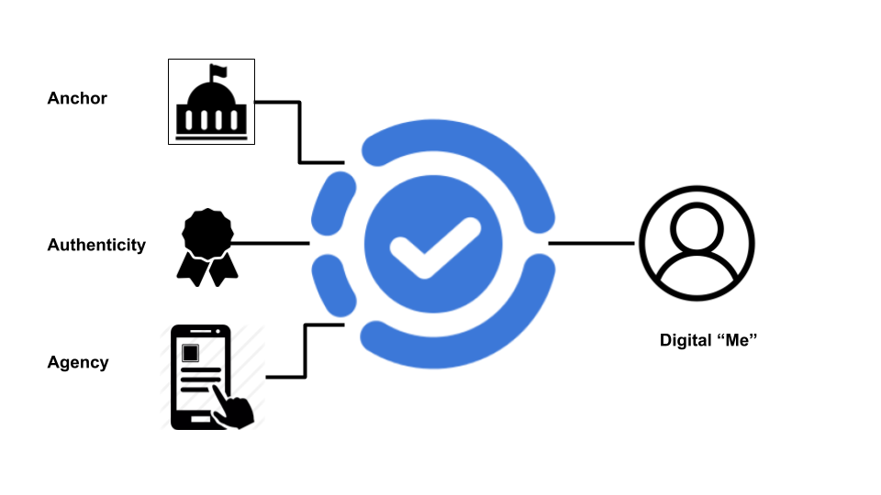
Self-sovereign decentralized identity
Notes:
Source: https://medium.com/@trbouma/self-sovereign-identity-cace196623c6

Slide 54
Blockchain-enabled Identity Services
Privacy-preserving decentralized identity services are becoming feasible
Service Providers use these records to verify authenticity of an identity
PoCs are around B2C
Decentralized identity and related evolving standards will be disruptive
Self-sovereign decentralized identity models put users in control
Identity trust fabric (ITF) immutably stores proof of identities cryptographically
Optimized Blockchain platforms can provide a suitable environment
Blockchain platforms are not mature yet!
Do not inherently meet all requirements for production ready ITF
Evolves in Self-sovereign Identity networks and verification services
Connecting identity owners, consumers, and services
Notes:
The blockchain concept has triggered a wave of innovation in identity and access management (IAM). This opens a path toward decentralized identity, where an entity generates and manages its own identity. Decentralized identity evolves federated and mobile identity models to a new level, one that is more aligned with privacy-by-design principles.
More organizations are deploying limited-scale decentralized identity services as proofs of concept (POCs), specifically for B2C use cases. The main objective is to learn, evaluate and increase readiness in preparation for large-scale deployment once a more mature design is available.
Decentralized identity and related evolving standards will be disruptive. Proof-of-concept projects have shown the potential benefits such as enhanced privacy, reduced security risk and cost-efficiency. However, there are still gaps and challenges that require more work.
Self-sovereign decentralized identity models put users in control and break identity silos, addressing requirements for reusable digital identities and relationship identification. Secure and scalable relationship identification is a key enabler of digital transformation.
Decentralized identity services are enabled by an identity trust fabric (ITF) that immutably stores the proof of identities and their profile attributes cryptographically. Service providers can use these records to verify the authenticity of an identity.
Blockchain platforms provide an early alternative for implementing the ITF as the key component of a decentralized identity architecture. However, blockchain platforms are not mature yet and do not inherently meet all business and technical requirements of a production-ready ITF.
Self-sovereign Identity networks and verification services are an evolution of decentralized identity
While efforts are underway to establish standards for these ecosystems, technical professionals should identify processes that will be affected and plan for integration scenarios in coming years.
Identity networks rely on a decentralized trust framework and marketplaces that connect identity owners, consumers and services. In addition to finalising technology development, a decentralized identity ecosystem requires establishing a viable trust and business model that drives broad adoption.

Slide 55
Identify relevant decentralized identity use cases for employees, business partners and consumers
especially to replace old register-store-verify methods of collection
Explore decentralized identity architectures
Establish a decentralized identity team for a small-scale PoC
Evaluate requirements against open issues such as compliance, initial identity collection, user experience, scalability, data revocation and update
Select solution partners, evaluate participation in consortium
Consider implication of direct user control of identities into life cycle processes
Notes:
To deliver effective and emerging identity and access management (IAM) capabilities:
Recommendations - Technical professionals responsible for delivering effective IAM capabilities:
Identify relevant decentralized identity use cases for employees, business partners and consumers to prepare for disruption. Gradually adopt a relevant trust framework, standard identifier scheme and verification exchange protocols that support integration with current IAM services and applications.
Explore decentralized identity architecture as an alternative to registration and verification of identities, especially if your organization is planning to modernize its customer/citizen identity management in the coming years.
Establish a decentralized identity team to initiate a limited-scale POC project to evaluate decentralized identity services. The team should experiment by adapting in-scope business processes to work with these solutions. Pilot projects should define business and technical requirements of identified use cases. These projects must also identify process and technical gaps, and development/improvement plans.
Evaluate your requirements against open issues in current decentralized identity solutions, such as compliance, initial identity proofing and binding, key management and user experience, ITF reliability and scalability, and attribute/certification revocation and update.
Select solution partners and evaluate participation in appropriate decentralized identity consortium or global identity networks. Prepare to revise existing identity life cycle processes that may be affected by issuing/consuming relationship credentials with direct user control.

Slide 56
Opportunities and Challenges
Successful blockchain enterprise production examples are still rare
Business leaders may not have clear where the value can be achieved
Most current experiments are just renovation attempts
There are still several business and technology challenges to adoption
What You Need to Know
Exploiting blockchain demands enterprises be willing to embrace decentralization in their business models and processes
Blockchain projects are not another arrow in the quiver
Reimagine by design thinking
Today’s technology are immature; will need pivoting in two years
Experiment, focus on the business problem, avoid vendor lock-in
Notes:
Opportunities and Challenges
Blockchain technologies offer new ways to exchange value, represent digital assets and implement trust mechanisms, but successful enterprise production examples remain rare.
Technology leaders are intrigued by the capabilities of blockchain, but they are unclear exactly where business value can be achieved in the enterprise context.
Most enterprise blockchain experiments are an attempt to improve today's business process, but in most of those cases, blockchain is no better than proven enterprise technologies. These centralized renovations distract enterprises from other innovative possibilities offered by blockchain.
The evolution of blockchain is rapid, but significant business challenges and technology gaps remain before blockchain is fully ready for widespread use.
What You Need to Know - Enterprise architecture (EA) and technology innovation leaders, CIOs, and technology and service providers (TSPs) seeking to exploit blockchain should know the following.
Blockchain technologies offer a set of capabilities that provide for new business and computing paradigms. Exploiting blockchain will demand that enterprises be willing to embrace decentralization in their business models and processes. It is not straightforward.
Blockchain technologies should not be treated as just another arrow in your quiver to solve enterprise efficiency issues. Such an approach will prove costly and have a high likelihood of failure.
Focus on reimagining by using design thinking, rather than merely replatforming.
Understand that today's technology offerings on blockchain are nascent and immature. You will need to pivot from today's technology within the next two years.
It is crucial to experiment and explore. Focus on the business problem — not the technology solution — and avoid vendor lock-in.

Slide 57
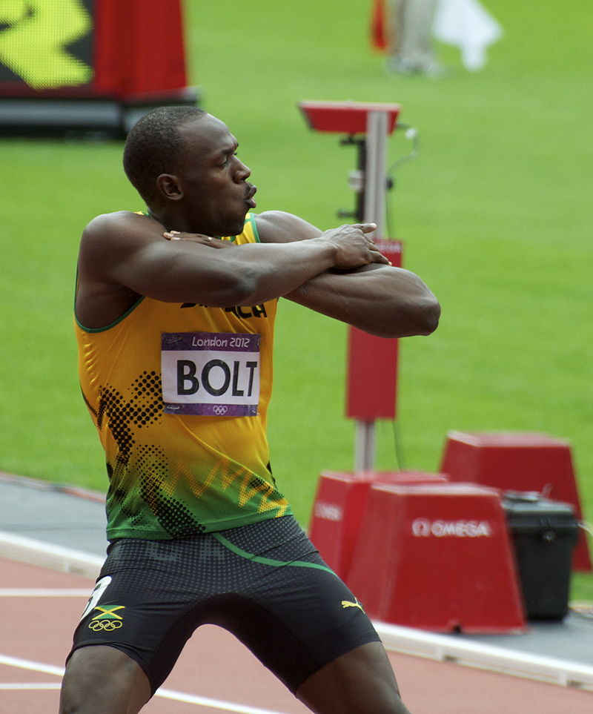
Characteristics of the Winners
Sustainable — or not yet "on the scene"
Functional governance
Open source
Configurable agreed formats
Open architecture/APIs
Tested in a public environment but able to run in private and public
Smart contract capabilities at multiple levels
Secure
Notes:
Sources: Gartner, https://commons.wikimedia.org/wiki/Usain_Bolt#/media/File:Usain_BoltLondon2012.jpg

Slide 58
Practice sound security and risk principles
Blockchain is early in its development, and long-term investments can be risky.
Complexity, cryptography and implementation errors may cool enthusiasm for blockchain and pose risks for users
Clarify risks at the business, technical and cryptographic levels
Evaluate the risks for any blockchain-based project, including technology, governance and compliance, human misunderstanding, and value at risk
Evaluate preparedness and incident response plans that will address critical security events during the blockchain life cycle, as these are to be expected
Temper the hype with effective risk-mitigation techniques
Notes:
Source: https://www.gartner.com/document/3869088
Security and risk management leaders must practice sound security and risk principles with emerging blockchain projects
Blockchain is early in its development, and long-term investments can be risky. Complexity, cryptography and implementation errors may cool enthusiasm for blockchain and pose risks for users
Clarify risks at the business, technical and cryptographic levels.
Evaluate the risks for any blockchain-based project, including technology, governance and compliance, human misunderstanding, and value at risk
Evaluate preparedness and incident response plans that will address critical security events during the blockchain life cycle, as these are to be expected
Blockchain is early in its development, and long-term investments can be risky. Complexity, cryptography and implementation errors may cool enthusiasm for blockchain and pose risks for users. Security and risk management leaders must temper the hype with effective risk-mitigation techniques
Security and risk management leaders must temper the hype with effective risk-mitigation techniques

Slide 59

Minimum Self-Defence
Be prepared to answer questions
how to securely implement blockchain-enabled business
processes and applications
Understand the differences regarding trust models
private, public and consortium
Evaluate the technical security aspects of blockchain platforms under consideration
Carefully evaluate applications for their suitability for integration with the specific blockchain systems and subsystems
Implement a vulnerability and incident management program
Continue to monitor key vendors
Notes:
Source: Gartner
Recommendations - As some organizations proceed with blockchain-based initiatives, SRM leaders must be able to inform and advise on the risks, benefits and limitations of this emerging technology. SRM leaders must:
Prepare themselves to answer questions about how to securely implement blockchain-enabled business processes and applications. Most importantly, this will depend on many factors, including which blockchain technology is selected. Familiarize with blockchain through early-stage research. Be aware that blockchain-based initiatives will differ dramatically from legacy business technologies and processes.
Understand the differences regarding trust models, from private, public and consortium. As such, security leaders must ensure that they have a general awareness of the relevant external groups/consortia. Specifically, SRM leaders should discover and track these initiatives that might line up with their industry. There is currently a heavy focus from a financial technology perspective. However, other industries will likely proceed with implementation projects (such as critical infrastructure, retail and government), as in Canada with digital identity.
A number of organizations are conducting experiments on bitcoin, while others are dipping their toes in the water with blockchain sandboxes from vendors like IBM and Microsoft. However, it should be noted that these sandboxes might not perfectly represent a full-scale blockchain environment. Ultimately, the industry is in a discovery phase with this emerging technology.
Evaluate the technical security aspects of blockchain platforms under consideration, and be cautious of overoptimistic claims by vendors. In particular, SRM leaders must consider how to ensure the confidentiality of blockchain-enabled applications while taking advantage of the integrity and availability benefits.
Understand the differences and determine the most appropriate blockchain platform for the use case(s) and organization. A number of vendors and providers have selected the bitcoin system, primarily because it has achieved a significant volume of nodes, for which bitcoin has a diverse and distributed network, providing all the fault tolerance and resilience capabilities discussed above. While this might suffice for some, it may not meet the needs and security requirements. For the short term, SRM leaders focused on experimentation can consider vendors such as IBM and Microsoft that provide sandboxes for which organizations can conduct early-stage blockchain PoCs. As mentioned previously, these sandboxes might not perfectly represent a full-scale blockchain environment, which may create a false sense of how the technology would operate in the wild.
Carefully evaluate applications for their suitability for integration with the specific blockchain systems and subsystems. This includes ensuring stringent security testing at all levels of the application stack, including operating systems (such as IoT or embedded operating systems), code review, application logic and architectural models for experimental systems (such as smart contracts built on top of blockchain technologies).
Implementing a vulnerability management program is a necessary component that aids security teams with the actionable insight and intelligence that aims to mitigate against a varying number of threats. This should include the blockchain application and infrastructure components as well. Implement transparency in governance and audit controls to (1) detect technical and administrative errors, (2) contain damage from malfeasance and (3) allow non-expert consumers and stakeholders to understand the integrity controls.
Finally, continue to monitor key vendors for feature innovation, consolidation or competitive threat capabilities. In some cases, question your current and future vendors about their capabilities with blockchain and the security thereof.

Slide 60
Embrace Digital Risk Management
The challenges:
Digital transformation has become business transformation and optimization, and blockchain is a potential critical capability enabling that convergence
Digital risk thinking and action is required to address blockchain risks
Blockchain risks can have requirements similar to DevOps
Evolve an effective risk management strategy:
Incorporate the new risk considerations – value transfer, contractual, resilience, privacy – when assessing blockchain initiatives
Develop a simple framework mapping strategic business risks with operational and IT risks
Notes:
Digital risk management is devoted to identifying and managing next-generation technology risks for trust capabilities — capabilities that are often not in widespread use — leaving security teams without established management approaches.
Digital risk management of blockchain initiatives is disruptive to current risk management practice.
Blockchain risks can potentially impact development operations (DevOps) and have the same requirements for continuous risk (re)assessment.
Recommendations - To operate and evolve an effective risk management strategy that includes blockchain initiatives, security and risk management leaders must:
Incorporate risk considerations that address value transfer, contractual, resilience and privacy risks when assessing the risks of blockchain initiatives.
Develop a simple framework that maps strategic business risks with operational and IT risks posed by blockchain initiatives for identification and assessment purposes.
Source: Gartner (August 2018)

Slide 61
Bonus Slides

Slide 62
GDPR and Blockchain – CNIL opinion (2018)
Participants are Data Controller if:
individual person, data treatment is professional or commercial
legal entity, writing personal information
If more than one person decides to process personal data:
Make arrangements regarding responsibility for processing
Creation of a legal entity that acts as data controller
Nominate a participant to act as a data controller
If not, everyone is a controller
Data Processors can also be "smart contract" developers and miners
On Public Blockchains, encouraged contractual solutions between participants
Notes:
CNIL comments: https://www.cnil.fr/sites/default/files/atoms/files/la_blockchain.pdf
First GDPR-centered analysis of Blockchain usage from CNIL
Data Controller – participants to the Blockchain act as data controller if:
participant is an individual person and data treatment is connected with professional or commercial activity;
participant is a legal entity and writes personal information on the Blockchain.
Whether more than one person decides to process personal data in a Blockchain for a common purpose, the CNIL recommends that
Participants make arrangements regarding the responsibility for processing
Creation of a legal entity that acts as data controller;
Nominate a participant to make decisions for the group and act as a data controller.
Otherwise, all participants will be considered as joint controllers.
Data Processors can also be
"smart contract" developer who processes personal data on behalf of the participant, controller;
miners who validate the recording of personal data in a Blockchain.
In the case of the public Blockchain, the CNIL is currently reflecting on and encouraging the development of solutions that allow the contractual relations between participants/controllers and miners to be defined.

Slide 63
Blockchain and e-voting – 1/2
It can’t be used unless violating basic democratic principles
A voter must be a citizen (authenticity)
Their voting choices must not be known, especially not on a public ledger (confidentiality)
The vote they cast isn't tampered with (integrity)
A voter shouldn't be able to prove who they voted for (avoiding bribery and vote trading)
A public final count so multiple people can validate the system as a whole
I have a key pair; the public key is signed by the State authority
Cast my vote by signing it with my private key and add it to the public ledger
Notes:
At least, not without violating multiple fundamental principles of democracy or making it seriously vulnerable. This is primarily because of the authenticity vs. voter anonymity problem. Consider this:
A voter must be a citizen (Authentic)
Their voting choices must not be known, especially not on a public ledger (Anonymous)
The vote they cast isn't tampered with (Valid)
A voter shouldn't be able to prove who they voted for (Bribery)
A public final count so multiple people can validate the system as a whole.
Ledger systems are supposed to guarantee validity - nobody can cook the numbers - but watch what happens when authenticity and anonymity are involved in this example voting system:
I create a cryptographic "key pair" - a private key that only I know and a public key that everybody can see. The Government signs my public key as proof that I'm a citizen using a Government private key.
I place my vote. I sign my choice using my private key and add it along with the Government signature to the public ledger for everybody to see.
It has these properties:
Nobody knows the Government private key so they can't place non-authentic votes.
Nobody should know my private key so they can't tamper with my vote either.
The Government signature provides authenticity and no other information is on the ledger, so it's anonymous too.
The final count is public because anybody can add together the votes.

Slide 64
Blockchain and e-voting – 2/2
However…
The State authority can use the signature to identify me and my vote
The State authority can create as many "citizens" as they want
Verifying a signature gives a cryptographic guarantee of exactly who I voted for
You can have a secret final count, but it still relies on “classical” security (e.g. server protection, network security)
Conclusions:
You have to choose between a secret ballot or a public ledger
If you choose secret ballot, the blockchain is useless
The State authority can direct the result by creating fake votes
Incompatible with “software independence”
Many of these applies to e-voting in general
Notes:
The State can use the signature to identify me and my vote. After all, the signature originated from them when they verified me as a citizen and it's also right there on the ledger next to my choices.
The State can create as many "citizens" as they want, completely undermining both authenticity and validity. Anybody looking at the ledger won't be able to notice anything.
Verifying a signature gives a cryptographic guarantee of exactly who I voted for; it's valid, sure, but it also opens up easy ways for people to bribe me.
So, anonymity is in contention with authenticity and validity is at odds with the ability to be bribed.
Estonia's e-Voting system currently has a secret final count - it's not a public ledger but the principle is the same. A public count is particularly important if, as seen in Estonia, the final vote counter is a single server that has been shown to be compromisable remotely. This means their entire democracy depends on a tiny group of people who make a series of rookie mistakes.
Conclusions:
In order to list out votes in a public ledger, so anyone can count them up to conclude the results and confirm their vote was included, we have to give up the secret ballot. Alternatively we give up the public count but in doing so we make the public ledger useless.
We also make ourselves vulnerable to fake citizens being created by the State with ease, major digital security threats and admin failures due to the layers of complexity. Note that many of these also apply to e-voting in general.
https://en.wikipedia.org/wiki/Software_independence - The term "software independence" (SI) was coined by Dr. Ron Rivest and NIST researcher John Wack. A software independent voting machine is one whose tabulation record does not rely solely on software. The goal of an SI system is to definitively determine whether all votes were recorded legitimately or in error. “A voting system is software-independent if an undetected change or error in its software cannot cause an undetectable change or error in an election outcome.”
It makes for an interesting concept none the less, but it doesn't come close to beating the simplicity and effectiveness of paper. Blockchain does not solve any problem that civil elections have.

Slide 65
Decentralized Autonomous Organizations (DAOs)
Online, digital entities that operate through the implementation of pre-coded rules
The thought is that if bitcoin can do away with financial middlemen, then maybe companies and other organizations can one day operate without hierarchical management
They need minimal to zero input into their operation
They work by executing smart contracts, recording activity on the blockchain
Described by What Hearn in 2009 as a company operating a driverless car fleet
Legal status: futuristic
Notes:
DAOs are essentially online, digital entities that operate through the implementation of pre-coded rules. These entities often need minimal to zero input into their operation and they are used to execute smart contracts, recording activity on the blockchain.
Modern legal systems are designed to allow organisations, as well as actual people, to participate. Most legal systems do this by giving organisations some of the legal powers that real people have – e.g. the power to enter into legal contracts, to sue, and to be sued. But what legal status will attach to a DAO? Are they simple corporations, partnerships, legal entities, legal contracts or something else?
Since the DAOs “management” is conducted automatically, legal systems would have to decide who is responsible if laws are broken. What, if, any, is the liability of DAOs and their creators? Who or what is claimed against in the case of a legal dispute?
Courts and regulators are unlikely to allow the wholesale adoption of technology which bypasses established oversight.

Slide 66

HODL
Slang term used originally in a bitcoin talk forum in 2013
The user was blatantly drunk and misspelled “holding”
He wanted to convey that we was holding despite the serious fall
The term become then very popular and has originated the backronym “Hold On for Dear Life”

Slide 67
Other Cryptocurrency Slang
Airdrop: the process of distributing tokens to wallets
Altcoin/Alt: any coin that isn’t Bitcoin.
Moon/Mooning is when a coin goes on a “bull run”, that is, when the price goes up quick
FOMO: Fear Of Missing Out, an emotional response that makes people impulse buy tokens at their all-time high
Gas: The Ethereum network requires one to pay “gas” to send a transaction or otherwise execute a smart contract
ICO: An initial coin offering
Lambo: Lambo is short for Lamborghini – sort of a status symbol, goal post, and/or meme.
Notes:
Source: https://cryptocurrencyfacts.com/a-quick-guide-to-cryptocurrency-terms/
Airdrop: The term airdrop is sometimes used to describe the process of distributing tokens to wallets. For example when the network of an ICO or fork goes live the newly created token might be airdropped to wallets of existing coin holders.
Altcoin / Alt: An altcoin (sometimes just called an “alt”). Any coin that isn’t Bitcoin.
Moon: Where you want your coin to pass by on its way to Mars. Mooning is when a coin goes on a “run” (AKA bull run). That is when the price goes up quick. The opposite is a crash, correction, or dip. Can’t get a Lambo without mooning, can’t see the moon if you don’t HODL. NOTE: You’ll make old school more virtuous crypto nerds cry if you say “Lambo, moon, and HODL” in the same sentence. So try to be polite and say “Tesla, Stratosphere, and Laddering” when appropriate.
FOMO: The Fear Of Missing Out. The emotional response that makes people impulse buy tokens at their all-time high. Try to not react to FOMO.
Gas: The Ethereum network requires one to pay “gas” to send a transaction or otherwise execute a smart contract. Gas can be paid in ether (but it is calculated in GWEI, where a GWEI is 1/1000000000th of an Ether.
ICO: An initial coin offering. A process that involves creating a new token and raising money for it. The process is often done using smart contracts on the Ethereum network. After a new token is created, it then has to be distributed. Sometimes to give a token value, to distribute it, and simply to help the devs raise money an initial coin offering is used.
Lambo: Lambo is short for Lamborghini. A Lambo is sort of a status symbol, goal post, and/or meme. Somehow everyone’s cognitive dissonance kicks in and there is this assumption that everyone who owns any amount of any tokens will somehow be driving a Lamborghini within the next 6 months. While it isn’t impossible, the only real bit of insanity here is trading in your coins for a physical object like a car [even a very cool car]. SAD!

Slide 68
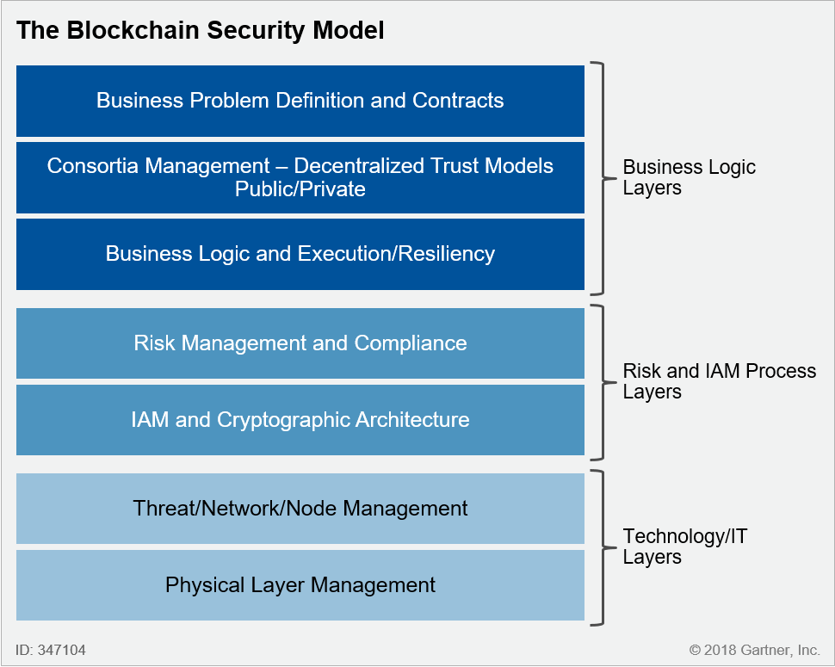
Gartner’s blockchain Security Model
Notes:
Source: Gartner
Organizations are embracing further conversations about risk appetite and risk tolerance in their planning for digital risk management.
Most production blockchain projects will be high-value. Current blockchain test projects would not be considered in this category.
SRM leaders will find that most production blockchain projects will use risk tolerance limits in their evaluation and analysis of risk, particularly operational risks as listed in the table. As a result, those leaders must adopt the terminology of risk appetite and tolerance, develop a lexicon of risks and avoid in the early stages strictly adhering to quantitative risk assessments that may defy substantiation.
Leaders should consider existing successful scenarios and “stories” of success to demonstrate risk tolerance of the specific project and how that reflects on their program’s risk appetite.

Slide 69
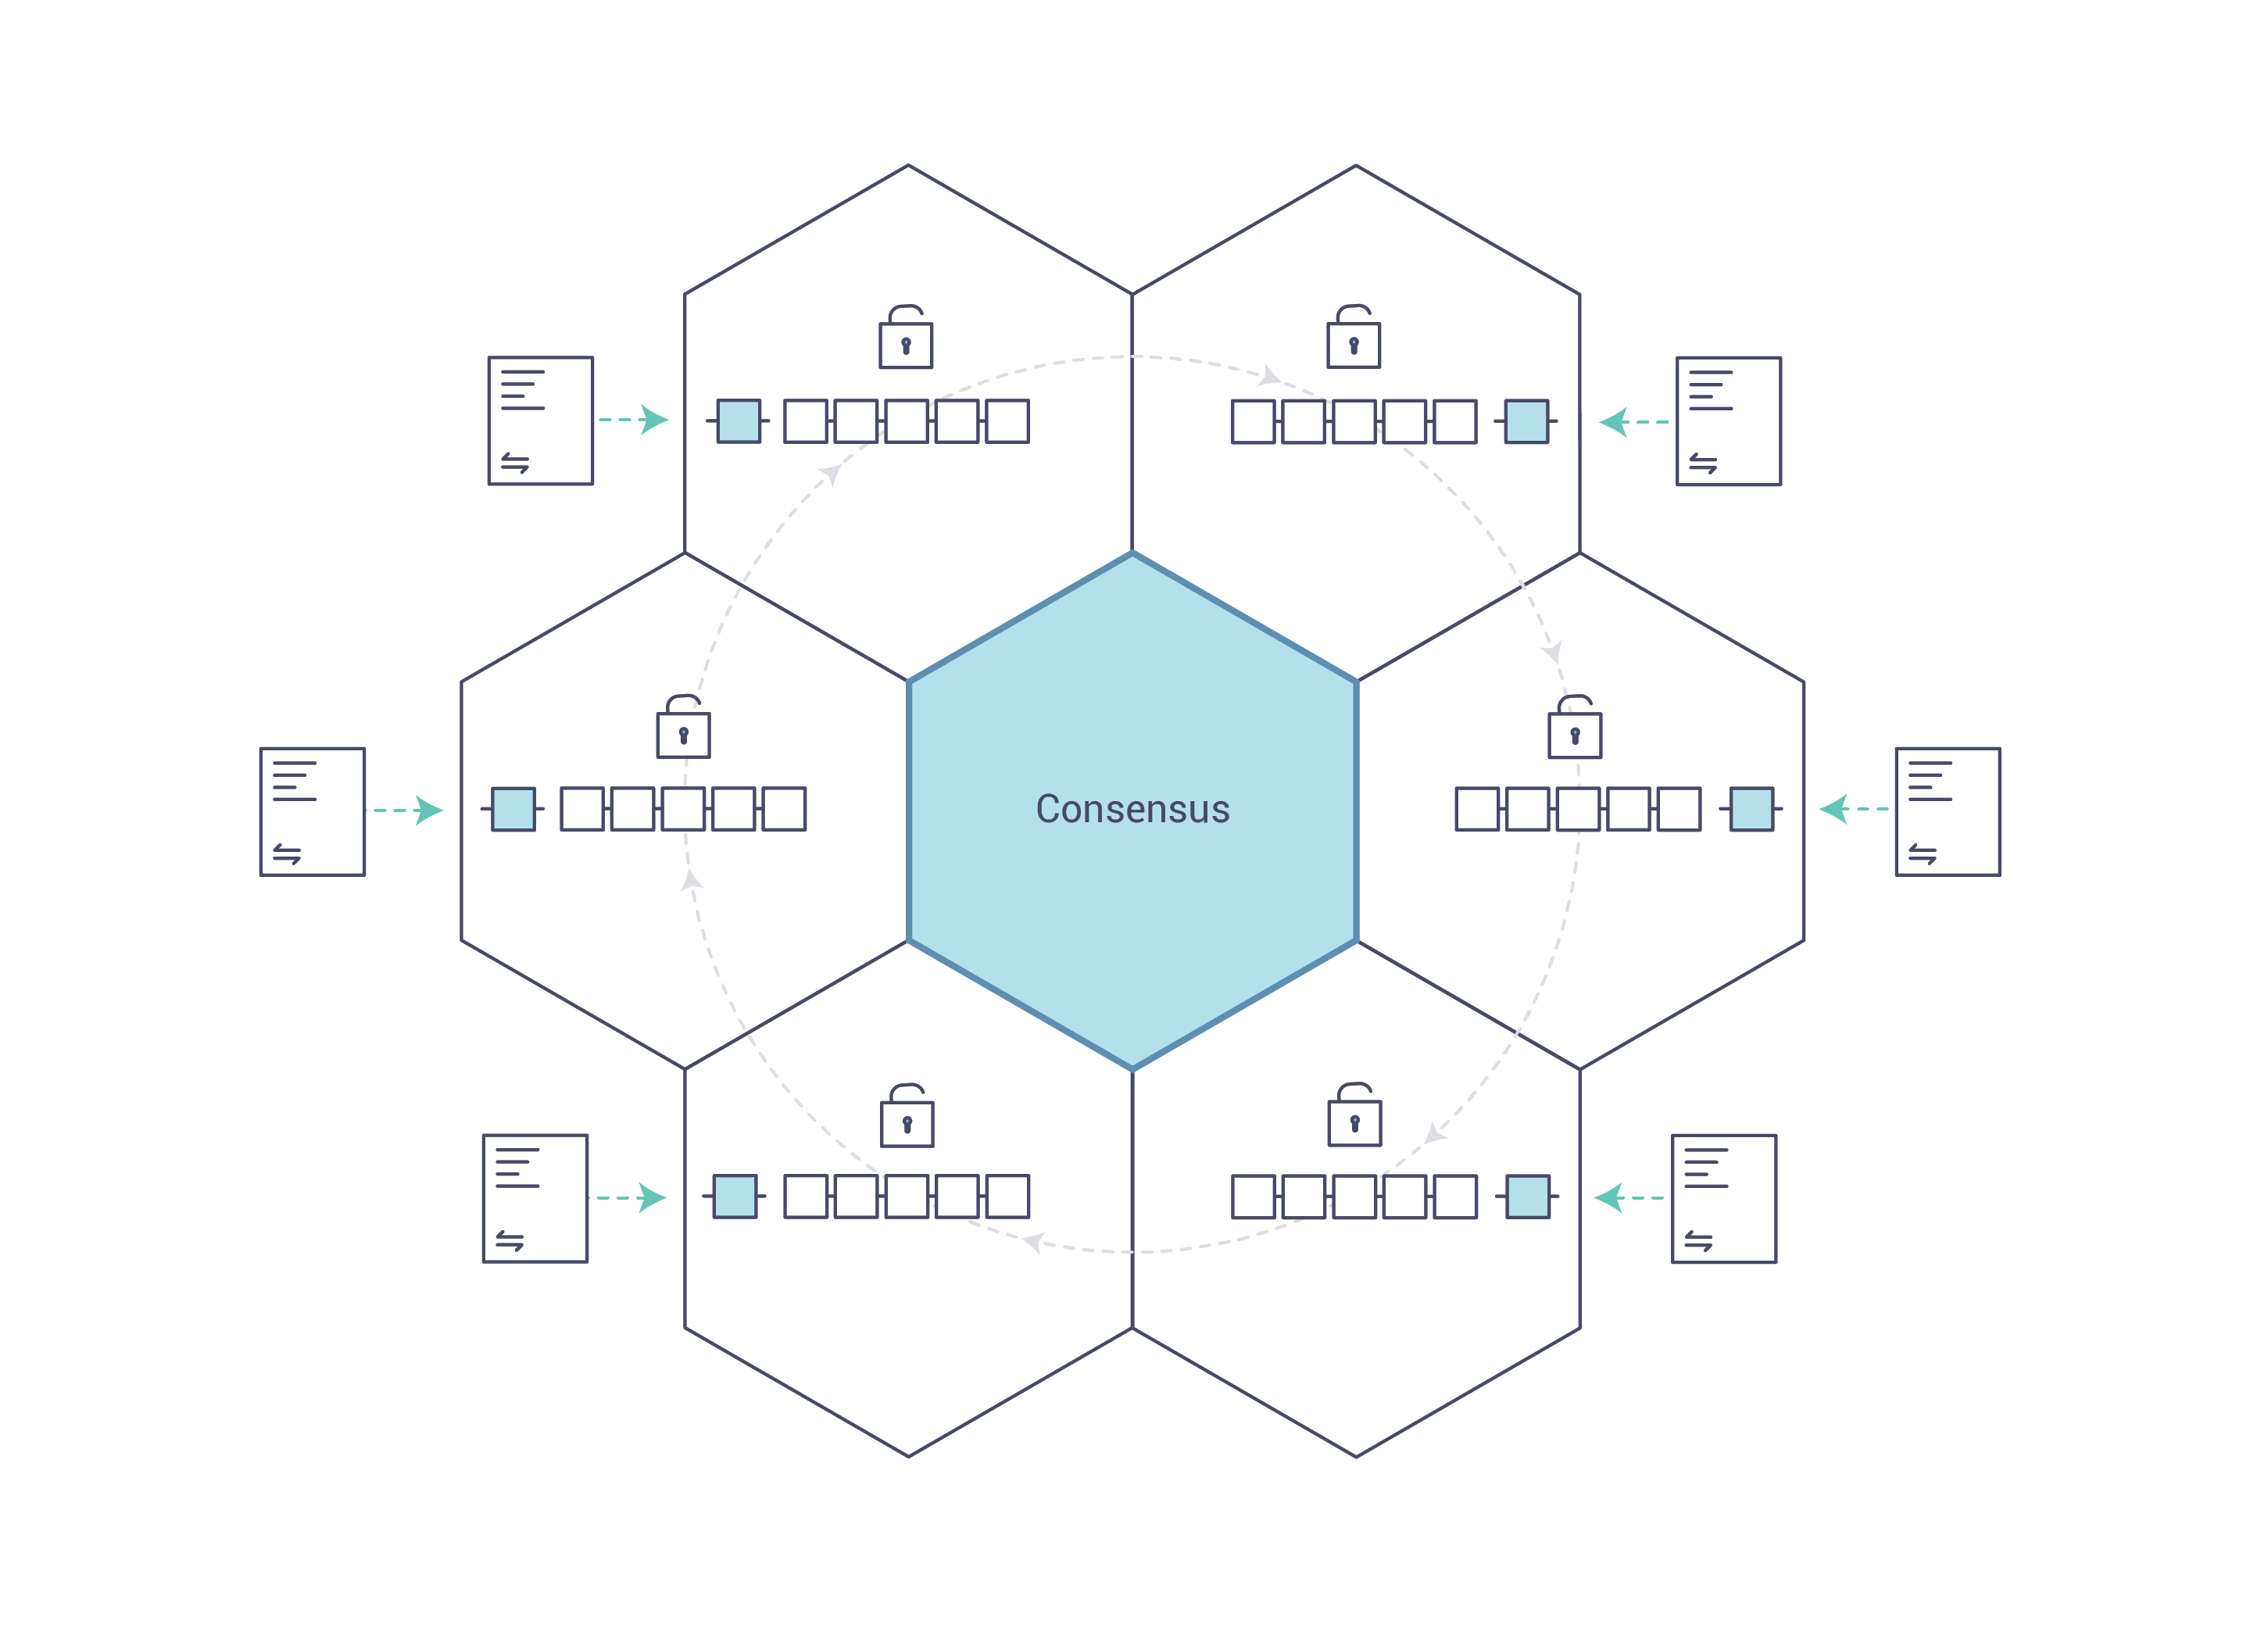
Consensus Mechanisms
Notes:
Source: Hyperledger
The process of keeping the ledger transactions synchronized across the network — to ensure that ledgers update only when transactions are approved by the appropriate participants, and that when ledgers do update, they update with the same transactions in the same order — is called consensus.

Slide 70
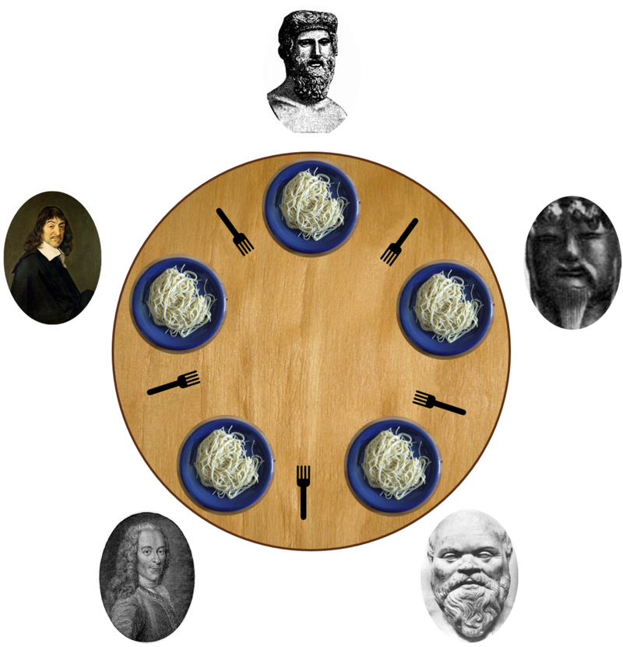
The story of consensus: the dining philosophers
Five philosophers sitting at a table
A fork between each of them
Must alternatively think and eat
Can only eat if they have two forks
Forks are single use
Can take a fork as it becomes available
But cannot start eating before they have two
Infinite supply and demand
Test: develop a concurrent algorithm which avoids deadlocks
Notes:
In computer science, the dining philosophers problem is an example problem often used in concurrent algorithm design to illustrate synchronization issues and techniques for resolving them.
It was originally formulated in 1965 by Edsger Dijkstra as a student exam exercise, presented in terms of computers competing for access to tape drive peripherals. Soon after, Tony Hoare gave the problem its present formulation.
Five silent philosophers sit at a round table with bowls of spaghetti. Forks are placed between each pair of adjacent philosophers.
Each philosopher must alternately think and eat. However, a philosopher can only eat spaghetti when they have both left and right forks.
Each fork can be held by only one philosopher and so a philosopher can use the fork only if it is not being used by another philosopher.
After an individual philosopher finishes eating, they need to put down both forks so that the forks become available to others. A philosopher can take the fork on their right or the one on their left as they become available, but cannot start eating before getting both forks.
Eating is not limited by the remaining amounts of spaghetti or stomach space; an infinite supply and an infinite demand are assumed.
The problem is how to design a discipline of behavior (a concurrent algorithm) such that no philosopher will starve; i.e., each can forever continue to alternate between eating and thinking, assuming that no philosopher can know when others may want to eat or think.
Source: https://en.wikipedia.org/wiki/Dining_philosophers_problem

Slide 71
Computational Consensus: Paxos protocols
Protocols for solving consensus in an unreliable environment, assuming participants and/or communication failures
Distributed computing spun off from here
Trade-offs on
number of processors
number of message delays before learning the agreed value
activity level of individual participants
number of messages sent
types of failures
Standard Paxos is slow and does not solve Byzantine Generals problem
Notes:
Paxos is a family of protocols for solving consensus in a network of unreliable processors. Consensus is the process of agreeing on one result among a group of participants. This problem becomes difficult when the participants or their communication medium may experience failures.
Consensus protocols are the basis for the state machine replication approach to distributed computing, as suggested by Leslie Lamport and surveyed by Fred Schneider. State machine replication is a technique for converting an algorithm into a fault-tolerant, distributed implementation. Ad-hoc techniques may leave important cases of failures unresolved. The principled approach proposed by Lamport et al. ensures all cases are handled safely.
The Paxos protocol was first published in 1989 and named after a fictional legislative consensus system used on the Paxos island in Greece. It was later published as a journal article in 1998.
The Paxos family of protocols includes a spectrum of trade-offs between the number of processors, number of message delays before learning the agreed value, the activity level of individual participants, number of messages sent, and types of failures. Although no deterministic fault-tolerant consensus protocol can guarantee progress in an asynchronous network (a result proved in a paper by Fischer, Lynch and Paterson), Paxos guarantees safety (consistency), and the conditions that could prevent it from making progress are difficult to provoke.
Paxos is usually used where durability is required (for example, to replicate a file or a database), in which the amount of durable state could be large. The protocol attempts to make progress even during periods when some bounded number of replicas are unresponsive. There is also a mechanism to drop a permanently failed replica or to add a new replica.
Source: Wikipedia

Slide 72
The Byzantine Generals Problem
A group of generals, each commanding a portion of the Byzantine army, encircle a city
These generals wish to formulate a plan for coordinated and agreed attack or retreat
Treacherous generals can cast suboptimal votes selectively
Generals are physically separated, messengers may lose or forge the vote
BFT can be reached if the loyal, non-faulty generals reach a majority
The metaphor is: computers are generals, networks are messengers
Notes:
Byzantine refers to the Byzantine Generals' Problem, an agreement problem, (described by Leslie Lamport, Robert Shostak and Marshall Pease in their 1982 paper, "The Byzantine Generals Problem"), in which a group of generals, each commanding a portion of the Byzantine army, encircle a city.
These generals wish to formulate a plan for attacking the city. In its simplest form, the generals must decide only whether to attack or retreat. Some generals may prefer to attack, while others prefer to retreat. The important thing is that every general agree on a common decision, for a halfhearted attack by a few generals would become a rout, and would be worse than either a coordinated attack or a coordinated retreat.
The problem is complicated by the presence of treacherous generals who may not only cast a vote for a suboptimal strategy, they may do so selectively. For instance, if nine generals are voting, four of whom support attacking while four others are in favor of retreat, the ninth general may send a vote of retreat to those generals in favor of retreat, and a vote of attack to the rest. Those who received a retreat vote from the ninth general will retreat, while the rest will attack (which may not go well for the attackers).
The problem is complicated further by the generals being physically separated and having to send their votes via messengers who may fail to deliver votes or may forge false votes.
Byzantine fault tolerance can be achieved if the loyal (non-faulty) generals have a majority agreement on their strategy. There can be a default vote value given to missing messages. For example, missing messages can be given the value <Null>. Further, if the agreement is that the <Null> votes are in the majority, a pre-assigned default strategy can be used (e.g., retreat).
The typical mapping of this story onto computer systems is that the computers are the generals and their digital communication system links are the messengers. Although the problem is formulated in the analogy as a decision-making and security problem, a component may appear functioning to one component and faulty to another, which prevents forming a consensus whether the component is faulty or not.
Sources: http://lamport.azurewebsites.net/pubs/byz.pdf, Wikipedia

Slide 73
Byzantine Generals’ Problems really happens
Not an academic discussion – it happened!
Mostly in aeronautics and space missions
A practical solution requires:
3f + 1 replicas to tolerate for ≤ f faulty nodes (to allow 2f + 1 quorum)
quorums(f + 1) out of 2f + 1 nodes in every operation
dealing with malicious primary
use a 3-phase protocol to agree on sequence number
dealing with loss of agreement
using strong cryptography so the adversary is unable to subvert it
Practical solutions based on fault tolerance are very complex, and can only tolerate 1/3 corruption of the nodes
Unpractical on large networks
Notes:
Despite widespread “it can’t happen” disbelief
https://c3.nasa.gov/dashlink/static/media/other/ObservedFailures1.html
https://zoo.cs.yale.edu/classes/cs426/2017/lecs/bft.pdf

Slide 74

Bitcoin

Slide 75
Bitcoin is born
The first and most widely used cryptocurrency
built upon a history of failed ones
inspired by Cypherpunk Movement of the 1980s
As Hashcash, relies on Proof-of-Work, a peer validation protocol
As Digicash, every node maintains a full copy of the ledger
As B-money, each node has its own identity
Bitcoin vs bitcoins vs satoshis
Aims to be pseudonymous, trustless, decentralized, immutable, democratic
Each computer is a node in the network
minting and distribution of bitcoins happens through mining
Deflationary currency
Notes:
Source: EdX, Berkeley University
Cryptocurrency is a completely digital, formless currency, tied together using computer science, cryptography and economics. Bitcoin is the first and most widely used cryptocurrency.
Bitcoin is inspired by the Cypherpunk Movement in the 1980s, which advocated for protection of privacy from external entities using cryptography. Satoshi Nakamoto first outlined and created Bitcoin in 2008 and 2009.
Relies on Proof-of-Work, a peer validation protocol introduced by Hashcash, that expends computational power to solve cryptographic puzzles and to cast votes.
As in Digicash, each node in Bitcoin maintains their own identity through public and private keys, authenticating transactions using blind signatures.
As in B-money, every Bitcoin full node maintains a copy of the blockchain.
Bitcoin: refers to the community, the network, and the software; bitcoins: the currency itself, a unit; 100,000,000 Satoshi= 1.00000000 ฿
Bitcoin aims to be pseudonymous, trustless, decentralized, and immutable. In addition, anyone with a computer and internet connection can join the Bitcoin network (democratic).
To maintain anonymity, it is best practice never to reuse pseudonyms. Bitcoin addresses are cheap to generate, and using a new pseudonym for each transaction makes tracking your activity and discovering your identity much more difficult.
Each computer is a node in the Bitcoin network, and each node may verify and audit the transaction history of their own funds.
In Bitcoin, the minting and distribution of bitcoins is determined through mining; since anyone can mine and win bitcoins, this process also aims to be decentralized.
Bitcoin is a deflationary currency, with 21 million total bitcoins that will be slowly introduced to the bitcoin supply via block rewards.

Slide 76
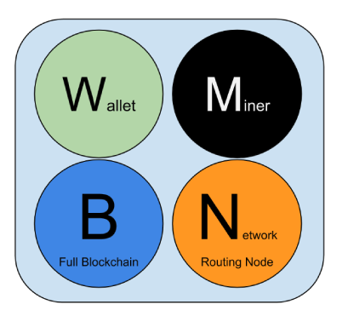
Four key functionalities of Bitcoin
Notes:
Bitcoin makes the distinction of 4 key functionalities that every node in the network is a combination of:
Wallets: management of keys and addresses
Mining: the voting process which expends computational power
Full Blockchain: a copy of the full Bitcoin blockchain – not necessary to participate
Routing: software that allows you to talk to other Bitcoin nodes
We can make powerful generalizations using these 4 key characteristics, however there exist other distinctions between users too.
Source: Berkeley, EdX

Slide 77

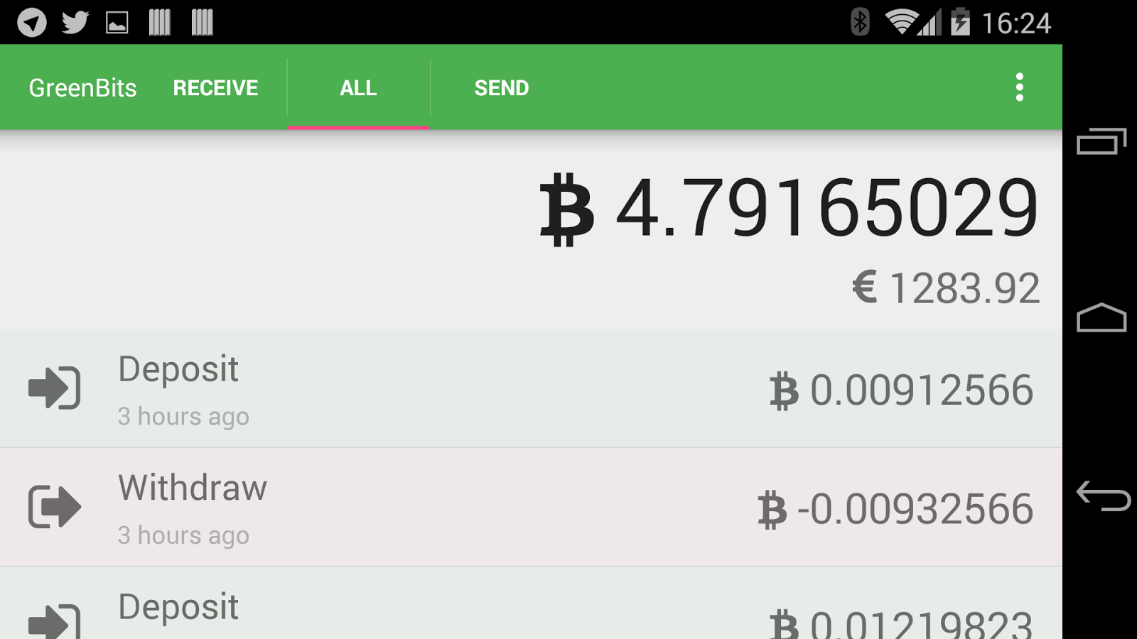
Wallets
Keep tracks of identities
Generate keys, track transactions
Do not store bitcoins! Control over private keys is essentially control over identity and bitcoins
Notes:
Wallets
The primary function of Bitcoin wallets is to keep track of your identity. In Bitcoin, a private key gives you a claim to your virtual identity; it unlocks your virtual identity and gives you access to your Bitcoin address. Wallets primarily store your private keys, but most wallet software also generate public/private keys with each new transaction and track your transactions.
Unlike the physical wallets we use for money, Bitcoin wallets do not store bitcoins. Control over private keys is essentially control over identity and bitcoins.
There are two types of Bitcoin wallets: hot wallets (Mycelium, AirBitz, Webapp, Mobile App, etc) are connected at some point to the internet, while cold wallets (i.e. paper and hardware) are not.

Slide 78
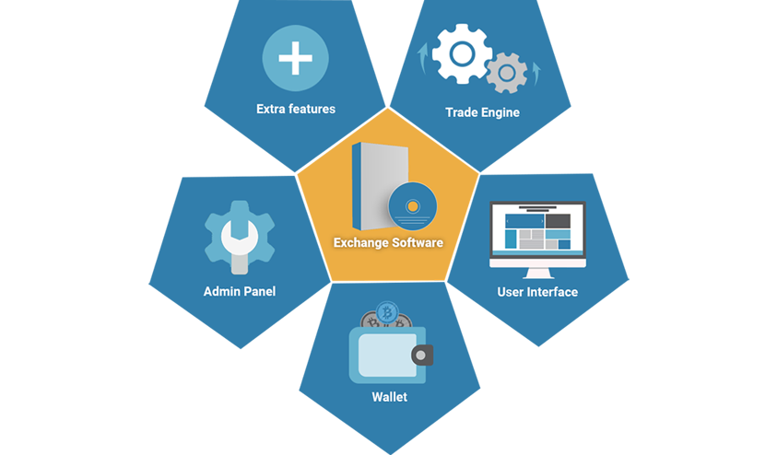
Bitcoin exchanges
Easy to use interface, low entrance curve
Wallets are stored online
Single points of failures
Decentralized exchanges uses “proxy tokens”
Loses the “JOBK” approach from wallets
hard to scale
Use Hierarchically Deterministic Wallets
Controller of parent is the controller of children
80/90% of transactions
Notes:
You can find them at Bitcoin ATMs, where you can trade cash for bitcoins.
You can also get bitcoins through an exchange, where you can trade between different types of fiat currencies and cryptocurrencies.
Centralized exchanges are easy to use and access, but are single points of failure which may be vulnerable to hacks.
Decentralized exchanges (i.e. Bitshares and Bitsquare) conduct trades directly between users by creating proxy tokens and are mostly trustless but may suffer from liquidity problems.
The traditional way to keep track of a large number of keys is through a “Just a Bunch of Keys” (JBOK) wallet: a new key pair is created and backed up for every transaction.
However, JBOKs are hard to scale. You can see how exchanges have to deal with thousands of transactions a day for thousands of users would need something more efficient than JBOK wallets.
Hierarchically Deterministic (HD) Wallets overcome this problem by deriving all new keys from an original random seed value.
In HD Wallets, anyone controlling the parent key can also generate and control child keys.

Slide 79
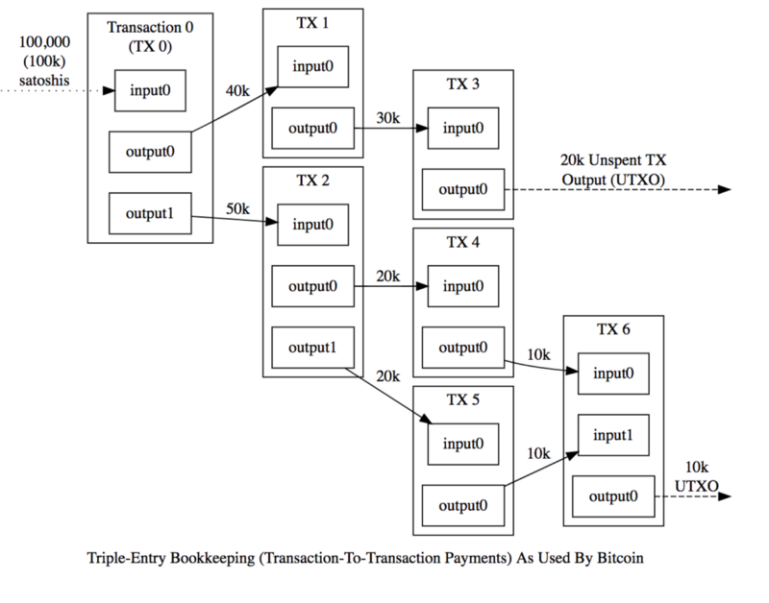


Unspent Transaction Output (UTXO)
Notes:
Sources: https://bitcoin.org/
https://www.flickr.com/photos/pictures-of-money/17121704418
Bitcoin uses the Unspent Transaction Output (UTXO), in which users spend directly from transactions made to them.
In Bitcoin, each transaction spends output from prior transactions and generates new outputs that can be spent by transactions in the future. All of the unspent transactions are kept in each fully-synchronized node, and therefore this model is named “UTXO”.
UTXOs should be seen as “piggy banks” as they store the token values.
Each transaction breaks the piggy and creates a new one
Each new UTXO uses the previous UTXO containing all the tokens as input of the new transaction
Input is always completely “spent”
Extra funds are sent to a “change” output
Any unallocated excess inputs are taken by the miner as the fee
The balance of a participant is calculated by the wallet keeping track of a list of unspent transactions associated with all addresses owned by the user, and the balance of the wallet is calculated as the sum of the unspent transactions

Slide 80
What makes a transaction valid?
Proof of ownership
Funds must be available
No other transactions using the same funds
storing transactions in “blocks”
transaction is sent to the network
transaction is “unconfirmed” until the next block is created (mined)
transaction is verified and included in the block
the transaction has now one confirmation
transaction fee given to the miner
Blockchain can only reach “eventual consistency”
Notes:
Source:
https://coincenter.org/entry/how-long-does-it-take-for-a-bitcoin-transaction-to-be-confirmed
https://github.com/bitcoin/bips/blob/master/bip-0050.mediawiki
What makes a transaction valid?
Proof of ownership (a signature)
In addition to proof of ownership, in order to be considered valid, transactions must also have enough available funds to spend from – token value stored in the Merkle tree node
Must also guarantee that no other transaction uses the same funds. This is done by:
Instead of storing transactions individually, Bitcoin batches them into “blocks,” built off of their previous blocks, thus forming the tamper-evident, blockchain data structure.
simply speaking, a transaction is “unconfirmed” once it has been produced and cryptographically signed, and “confirmed” once it has been successfully included in the blockchain.
To add a transaction to the blockchain, a new block must be mined
Once that block is created and the new transaction is verified and included in that block, the transaction will have one confirmation.
The blockchain does not offer strong consistency, meaning that any data included in the blockchain is guaranteed to be included forever. For technical reasons, the blockchain offers a weaker property called eventual consistency, meaning that eventually all parties will agree on the blockchain up to a certain ever-increasing prefix.

Slide 81
Bitcoin consensus is a complicated concept
There is no absolute notion of “permanently included”
Agree on which update is added to the blockchain
prevention of Double Spend Attacks
Everyone can cast votes, but to do so requires computational power
Proof of Work – mining – prevention of Sybil Attacks
Need to be part of the winning fork
Reorganizations can happen, leaving “orphans”
Single blocks are orphaned daily, but rarely more than one
6 blocks is the standard confirmation period, but it can vary
1 block every 10 minutes, 6 blocks = 1 hour
Notes:
Sources: https://coincenter.org/entry/how-long-does-it-take-for-a-bitcoin-transaction-to-be-confirmed
Consensus is complicated
At a high level, a transaction is confirmed when it is permanently included in the Bitcoin blockchain. The important takeaway though is that there is no absolute notion of “permanently included” and the community simply uses a reasonably safe policy of considering transactions confirmed when they are “included with very high probability.” The time it takes for this to happen is quite variable-sometimes confirmation may be tens of minutes and sometimes it may take over two hours, but on average it will take about an hour.
Users on the blockchain must come to a consensus on which updates and blocks to add to the blockchain. Doing so also prevents Double Spend Attacks. Bitcoin uses a form of peer validation to build a shared transaction history; everyone on the network casts votes on the validity of a transaction.
Proof-of-Work: require that each nonce be chosen such that the resulting SHA-256 block hash starts with X consecutive zeroes, where X can be changed to calibrate difficulty. This ties voting power to computational power rather than digital identity, and was designed to prevent the Sybil attack, where a malicious actor creates many identities to skew the vote. However, due to an uneven distribution of computational power, Satoshi Nakamoto’s “1 CPU 1 Vote” vision is not reflected perfectly in reality.
The blockchain is a series of n blocks (currently almost 400,000), and at any given time the most recent several blocks are not guaranteed to be permanently included. It is possible for the blockchain to fork by having multiple potential (often inconsistent) blocks which claim to be the last block in the chain. Eventually one of these blocks will win and be permanently included, but it won’t always be immediately clear which block this is.
When an apparently valid block is replaced by a competing block, this is called a blockchain reorganization and the replaced block is called an orphan block.
Given this we might be tempted to say a transaction is “confirmed” once it has been included in a block which is not the very last block in the blockchain. However, it is possible (although rare) for the last n blocks to be orphaned in a reorganization. This is exponentially less likely to occur the larger n gets. It typically happens multiple times a day, for example, that a single block is orphaned, but has happened only a few dozen times in history for n between 2 and 4, and exactly once for n greater than 4 (a 24-block reorganization in March 2013 due to a technical glitch).
In practice, the community has adopted 6 blocks as a standard confirmation period. That is, once a transaction is included in a block in the blockchain which is followed up by at least 6 additional blocks, the transaction is called “confirmed.” While this was chosen somewhat arbitrarily, it is a reasonably safe value in practice as the only time this would have left users vulnerable to double-spending was the atypical March 2013 fork.
For very large transactions, coin owners might want to wait for a larger number of “block confirmations” and most wallet software now says more precisely that a transaction is “confirmed by n blocks” to enable users to decide for themselves if more confirmation is needed.
For relatively small transactions (like buying coffee), users might be fine with a shorter confirmation period such as one or even zero blocks. Even with only 1 confirmation (accepting a transaction once it is included in the most recent block in the chain) the risk of losing it to a reorganization is low (1-2%) and even then it will probably be re-included after the reorganization occurs.
Cryptoexchanges normally require at least 3 confirmations to confirm a transaction

Slide 82
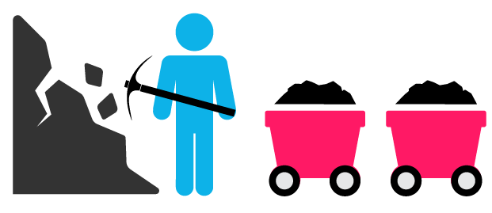

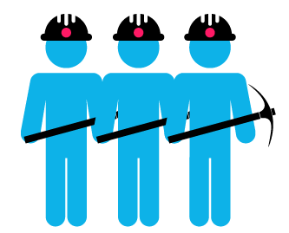
Proof of Work (PoW) in Bitcoin
The concept is to use resources instead of identities
Through blockchain and PoW, Bitcoin successfully overcome the difficulties of:
ensuring every node holds a consistent version of the transaction history
identifying malicious actors
blocking both Sybil and Double-Spend attacks
Innovative combination of PoW, signatures, Merkle chains, P2P
Notes:
Source: Blockgeeks, Keepingstock
The concept is to use resources instead of identities – makes attacks like DoS or Double Spending very expensive to do
PoW is the requirement to define an expensive computer calculation, also called mining
Mining in Bitcoin requires miners to verify incoming transactions, create a block, find a valid nonce, broadcast the block, and earn a profit in bitcoins.
Miners are primarily motivated to maintain the network, or execute the Proof-of-Work consensus mechanism and bring new bitcoin into circulation, by earning profit. Miners only earn a profit from mining when the revenues from the block reward and the transaction fees are greater than the fixed and variable costs of mining.
A reward is given to the first miner who solves each block problem (although more complicated)
Network miners compete to be the first to find a solution for the mathematical problem.
Some of the challenges Satoshi overcame using blockchain and Proof-of-Work are:
The difficulty to ensure every Bitcoin node holds a consistent version of the transaction history
The difficulty to identify malicious actors
These conditions may normally allow a node to conduct a Double Spend Attack, in which the one spends the same funds more than once by tricking parts of the network to believe different versions of the transaction history.
A Sybil Attack is where users create multiple identities for malicious purposes (e.g. casting more votes); Bitcoin employs Proof of Work, where voting power is based on computational power, to make voting expensive
POW is not a new idea, but the way Satoshi combined this and other existing concepts — cryptographic signatures, Merkle chains, and P2P networks — into a viable distributed consensus system, of which cryptocurrency is the first and basic application, was quite innovative.

Slide 83
Bitcoin is robust
Bitcoin is robust because it serves the same functions as a bank:
Account management
Legitimacy
Record-keeping
Unlike a bank, is decentralized and ensures a high degree of privacy and trust
authentication based on public/private key pairs
public keys are used to send and receive funds
private keys to prove ownership and redeem sent funds
each individual is responsible for their own keys
private keys are randomly generated
much cheaper than a bank (for big transactions)
Notes:
Source: EdX, Berkeley University
Bitcoin is robust because it serves the same functions as a bank:
Account management; the Bitcoin protocol gives users a way to create and manage their own identities (account)
Legitimacy; It ensures we are legitimate owners and accessors of our accounts
Record-keeping; It honestly records account balances at each transactions.
Unlike a bank, Bitcoin is decentralized and ensures a high degree of privacy (via pseudonyty) and trust.
Trust is built on the blockchain due to a high level of transparency: blockchain is a publicly verifiable ledger, not owned by any entity, and it prevents any single point of failure.
To maintain this trust, we need identity in Bitcoin for authentication and assigning blame. Bitcoin uses public keys, generated from Private keys, to send/receive funds, and private keys to prove ownership of the public key and redeem the sent funds.
Each individual is responsible for creating and managing their own private and public keys.
Private keys are randomly generated. The chances of guessing the same private key are very low.
Banks can charge 10,000 USD for a movement of 1,000,000 mm USD (1-2%); in Bitcoin, the fee does not depend on the amount of the transaction itself

Slide 84

First bitcoin physical purchase
Notes:
The first transaction using Bitcoin to purchase a tangible asset occurred in 2010, when Laszlo Hanyecz exchanged 10,000 bitcoin for $25 worth of pizza. This exchange gave bitcoins real value, a first step towards legitimacy.
(at the change of today, 55,831,358.17 Euro!)

Slide 85
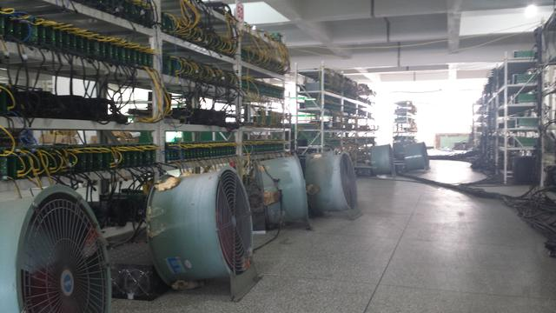
Bitcoin critics
Notes:
Not dealing with criminal issues – kind of side effect of the Cypherpunk ideology.
Even with the most impressive technology, it still takes a great amount of time and power to find a block. Mining pools allow miners to join their hash power together so that they will collectively find blocks and collect rewards more often, reducing variance. As a member of a mining pool, your reward is calculated by the number of “shares” you contribute. A share is defined as a near valid block, used to estimate the mining power you contributed. More shares equals more attempts at finding a valid nonce equals a larger slice of the pie.
One of the current challenges of Bitcoin is that mining is tending towards centralization with the development of ASICs, mining pools, and mining farms. ASICs cost a lot of money, which means only those with access to high volumes of capital can afford them, thereby concentrating the mining power into the hands of a few.
We can get around the ASIC domination by creating a memory-hard or memory-bound puzzle, periodically switching mining puzzles, or replacing Proof of Work by Proof of Useful Work.
While ASIC resistance may decentralize mining and make it a more democratic process, achieving ASIC resistance may also cause disruptions to the mining community that would undermine the network.
Real changes are implemented in Bitcoin via hard or soft forks. Hard forks result from a new protocol that does things not allowed in the old protocol. In a soft fork, the rules of the protocol are only restrained. A soft fork is backwards compatible but not forwards compatible.
Bitcoin uses up to 57 TWh per year, enough to power more than 5 million US households.
Certainly, printing paper money and coins has more worldwide impact – think about mining zinc
Transaction fees have reached 55 USD, making everyday purchases impractical.
Sources:
https://money.cnn.com/2017/12/07/technology/bitcoin-energy-environment/index.html
The Register
https://digiconomist.net/bitcoin-energy-consumption
https://qz.com/1204840/iceland-will-use-more-electricity-mining-bitcoins-than-powering-homes/

Slide 86
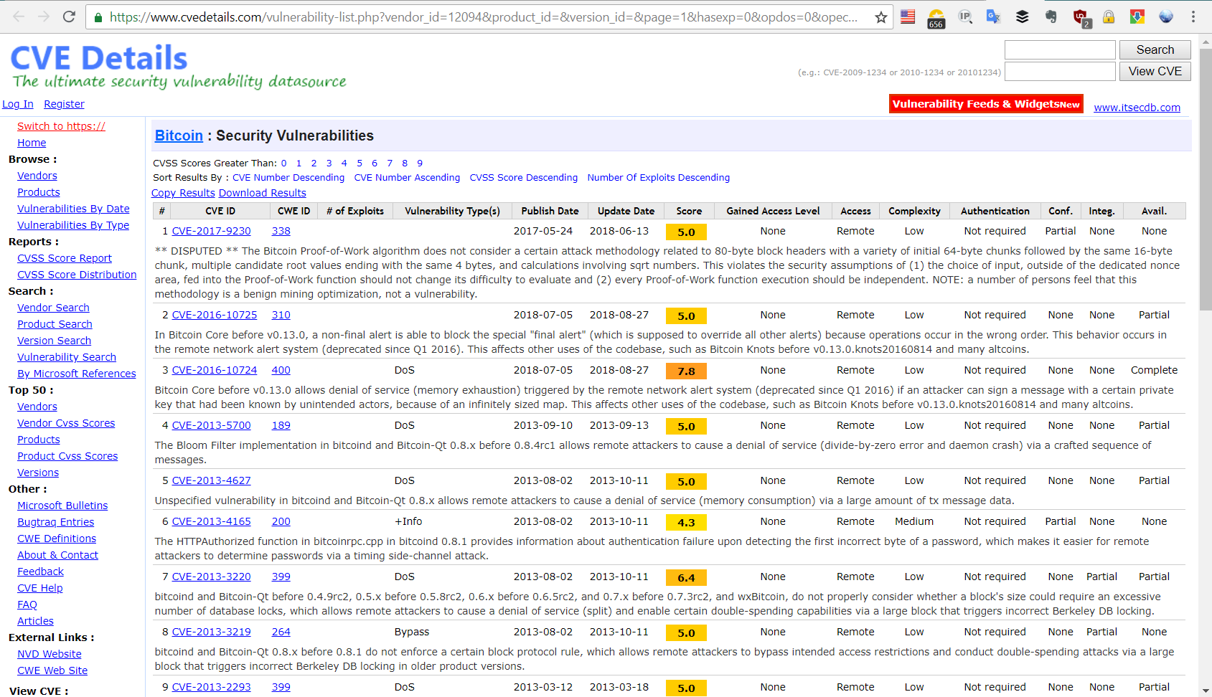
Bitcoin had its share of vulnerabilities
Notes:
https://www.cvedetails.com/vulnerability-list.php?vendor_id=12094&product_id=&version_id=&page=1&hasexp=0&opdos=0&opec=0&opov=0&opcsrf=0&opgpriv=0&opsqli=0&opxss=0&opdirt=0&opmemc=0&ophttprs=0&opbyp=0&opfileinc=0&opginf=0&cvssscoremin=0&cvssscoremax=0&year=0&month=0&cweid=0&order=1&trc=0&sha=02bb04436da122c2c495300fcd2c941b9e4a7d6f
https://en.bitcoin.it/wiki/Weaknesses

Slide 87

Ethereum and the Account/Balance model
Ethereum designed to run “smart contracts”
users pay for running their code
uses a simplified system for transactions
Less privacy than Bitcoin
Exposed to Double Spending Attacks
However, simpler and more efficient
Hyperledger adopts UTXO
Ethereum suffered a hack and fork in 2016
Notes:
Source: https://medium.com/@sunflora98/utxo-vs-account-balance-model-5e6470f4e0cf
Berkeley / EdX
Ethereum is a platform designed to execute arbitrary code called “smart contracts”. Users pay for code execution using Ethereum’s internal token, called ether.
Alice gains 5 ethers through mining. It is recorded in the system that Alice has 5 ethers.
Alice wants to give Bob 1 ether, so the system will first deduct 1 ether from Alice’s account, so Alice now has 4 ethers.
The system then increases Bob’s account by 1 ether. The system knows that Bob has 2 ethers to begin with, therefore Bob’s balance is increased to 3 ethers.
Analogy is with a bank, which keeps track of how much you spend and verifies your balance before approving the transaction.
One drawback for the Account/Balance Model is the exposure to double spending attacks (there are mitigation mechanisms to prevent it)
Simplicity — Ethereum opted for a more intuitive model for the benefit of developers of complex smart contracts, especially those that require state information or involve multiple parties. An example is a smart contract that keeps track of states to perform different tasks based on them. UTXO’s stateless model would force transactions to include state information, and this unnecessarily complicates the design of the contracts.
Efficiency — In addition to simplicity, the Account/Balance Model is more efficient, as each transaction only needs to validate that the sending account has enough balance to pay for the transaction.
Like most things in computer architecture, both models have trade-offs. Some blockchains, notably Hyperledger, adopts UTXO because they can benefit from the innovation derived from the Bitcoin blockchain.
With Ethereum’s introduction, Distributed Autonomous Organizations (DAOs), programs on the Ethereum blockchain that create a distributed government, gained popularity. “The DAO” was a decentralized Venture Capital DAO that suffered a $120 M hack in 2016. Disagreement about whether to roll back the history of transactions to before the hack led to two versions of Ethereum. Ethereum(the main chain) rewound the transaction history to before the hack, whereas Ethereum Classic continued the original chain despite the hack.

Slide 88



Ethereum and the Proof-of-Stake model
The creator of the new block is chosen deterministically, depending on its “wealth” – also defined as Stake
All digital currencies are already minted. In the PoS model there is no block reward, so the miner takes the transaction fee
Currencies based on PoS are expected to be thousands of times more cost effective
Notes:
Consensus Mechanisms: Proof of Stake
Proof of stake is a different way to validate transactions based and achieve the distributed consensus. It is still an algorithm, and the purpose is the same of the proof of work, but the process to reach the goal is quite different.
Unlike the proof-of-Work, where the algorithm rewards miners who solve mathematical problems with the goal of validating transactions and creating new blocks, with the proof of stake, the creator of a new block is chosen in a deterministic way, depending on its wealth, also defined as stake.
Also, all the digital currencies are previously created in the beginning, and their number never changes. This means that in the PoS system there is no block reward, so, the miners take the transaction fees. This is why, in fact, in this PoS system miners are called forgers, instead. In Proof-of-Stake, forgers are always those who own the coins minted. There may be other PoS models where the priority scheme for getting inducted into the validator pool itself is different. Validators get a reward (somewhere around 2-15%)
The idea is that Proof of work is expensive, likely to result in future scalability and security issues and not necessarily appropriate outside of financial transactions, as a transaction processing fee is used as an incentive for participants. Proof of stake has been mooted as a more widely appropriate solution, as the enforcement costs are lower, and compromise is considered to be more difficult (this is debated, as the underlying PoS algorithm must be as bulletproof as possible because, without especially penalties, a proof of stake-based network could be cheaper to attack). Proof of stake has the benefit of determining eligibility to participate in the blockchain consensus, as well as reducing risk of "split"— where two or more parties claim to be the source of truth.
In Ethereum the winner team is the initial one. There is no equivocating about who decides.
Security leaders must understand the benefits of proposed blockchain proof systems, whether proof of work or a proof of stake variant, and must understand the risks of the particular proofing system being proposed, as this will be the key determinant of blockchain integrity.

Slide 89
Smart Contracts and Smart Assets
Piece of business logic codified into programming language – “Dapp”
Coupled with a blockchain transaction
Participates to the verification of the transaction
Digitally facilitates, verify, or enforce negotiation or performance of a contract
The contract must be executed for the transaction to complete
Allows for parties to include provisions on how funds are released
Has usually a UX that emulate the logic of contractual clauses
The idea is that many kinds of contractual clauses may be made partially or fully self-executing and/or self-enforcing
Aim to be more secure than traditional contracts and reduce costs
Smart Assets are digital properties
Notes:
Source: Gartner
Smart Contracts (and Smart Assets)
A smart contract is a set of business logic codified into programmatic form, coupled with a unit of value or a transaction within its scope.
Also called Dapp, or decentralized application. For example, Cryptokitties (a blockchain-based game that exists on the Ethereum platform where you collect digital cats).
The essential idea of the smart contract is that the transaction can be verified programmatically via the blockchain, instead of via a central arbiter.
It is intended to digitally facilitate, verify, or enforce the negotiation or performance of a contract, or that make a contractual clause unnecessary.
The contract must be executed for the transaction to complete.
Depending on the goal and structure of the blockchain environment, parties can therefore agree between themselves on how goods and services can be delivered, and the terms by which funds can automatically be released (or how penalty charges can be imposed, for that matter).
Smart contracts usually also have a user interface and often emulate the logic of contractual clauses.
Proponents of smart contracts claim that many kinds of contractual clauses may thus be made partially or fully self-executing, self-enforcing or both.
Smart contracts aim to provide security superior to traditional contract law and to reduce other transaction costs associated with contracting.
The smart asset can be viewed as a digital property that has embedded within it a concept of ownership as well as dynamic behaviour, which can be a human, a corporation or another smart asset.

Slide 90
Other Consensus Mechanism
Different uses of blockchains and different use cases require different consensus mechanisms
Some want to address ASIC resistance, other resistance to centralization, other wants the proof to be delegated off-blockchain, others to address scalability and performance, etc.
Proof of Elapsed Time (PoET) = by Intel, used by Hyperledger Sawtooth
Delegated Proof of Stake (DPoS) = faster version of PoS using delegates
Proof of Burn (PoB) = burn some tokens to get the chance to vote
Proof of Authority (PoA) = validators stake their reputation in the network
Practical Byzantine fault-tolerant (PBFT) = low latency version of BFT
Byzantine Altruistic Rational (BAR) = assumes rational adversaries
several others….
Notes:
Like a box of chocolates, consensus mechanisms come in a number of forms and won’t bring about the same result for every palate, or blockchain network, where they are used.
1. The Proof of Elapsed Time (PoET) consensus mechanism operates in a similar fashion. For starters, PoET is used on a permissioned blockchain, meaning that every node in the system must be (1) identifiable, and (2) accepted into the network. In the class, all students know each other, and everyone had to be enrolled in the course to take the final.
But, there’s a twist. With PoET, the “timer” is different for each node. Every participant in the network is assigned a random amount of time to wait, and the first participant to finish waiting gets to commit the next block to the blockchain. Similar to pulling straws, but this time, the shortest stem in the stack wins the lotto.
PoET In Action: The PoET consensus mechanism was conceived by Intel in 2016 and can be used by Hyperledger Sawtooth, a platform that can build, deploy, and run distributed ledgers.
Difference from Proof of Stake: By requiring each node to “rest”, PoET is believed to be more energy efficient than PoS.
2. Delegated Proof of Stake (DPoS)
Today’s consensus mechanism takes us for a democratic spin. As you might’ve guessed, DPoS is a twist on Proof of Stake consensus that relies upon a group of delegates to validate blocks on behalf of all nodes in the network.
There are typically 21 to 100 delegates elected in networks using DPoS consensus. That headcount is a considerable drop from the 535 Members of Congress we’re used to seeing in the states, though as is the case here — and for Charmin’ Ultra — less is more.
The reason: Organization. Was your class ever instructed to line up in height order? Finding your position among a small group of peers is difficult enough. Roping in the entire grade makes it unnecessarily dicey.
The same idea applies with delegates. It’s easier for them to assemble themselves and allocate slots in which each delegate will publish their block when fewer parties are involved. And should a delegate fall out of line by either late or faulty reporting, nodes within the network can vote in a replacement.
Pros: Scalable, energy efficient, cheap transactions.
Cons: Partially centralized (Scalability Trilemma).
DPoS in action: BitShares, EOS, and Steemit all use Delegated Proof of Stake. However, the more interesting detail is that all projects are the brainchild of Dan Larimer. After all, he’s also the mastermind behind Delegated Proof of Stake consensus.
3. Proof of Burn
At first glance, applying the “proof of ___” metric to PoB seems… complicated. How does one “burn” digital currencies that, at their base level, are strings of code?
The answer: Eater addresses. Also known as an unspendable address, eater addresses are on the receiving end of all proof of burn transactions. They’re storage cells for coins sacrificed through proof of burn consensus.
Because addresses are generated randomly, it’s believed that nobody (not even miners) can determine the private key. So, the name abides — coins are effectively eaten.
Of course, there’s an incentive for burning a hole in your pocket. A user who gives up short term wealth proves that they are following the consensus mechanism and is rewarded with a lifetime privilege to mine the next block on the blockchain.
More burnt coins = greater odds of being selected. However, stakes decline over time, meaning that you’ll need to burn tokens every now and then to continue receiving block rewards at about the same rate.
Pros: Like we mentioned, proof of burn consensus sets you back in the short term. The possibility for larger gains in the future could incentivize users to remain involved in the project, thereby preserving the network.
Cons: Proof of burn is comparable to Plinko — burning coins doesn’t guarantee that you’re selected to mine future blocks. And similar to proof of stake, the process favors whales who can commit more capital, tilting the odds in their favor.
PoB in action: Slimcoin uses proof of burn as a consensus algorithm, and Counterparty uses proof of burn to “seed” tokens. Seeding is a way to bootstrap one cryptocurrency by burning another. With Counterparty, users transfer Bitcoin to an eater address and receive XCP tokens in return.
4. Proof of Authority (PoA)
Blockchains are cutting edge technology, but they have their limitations. Like most systems, blockchains have tradeoffs. Vitalik Buterin refers to this as the ‘Scalability Trilema’, identifying three desired attributes of blockchains:
Scalable
Decentralized
Secure
Similar to the collegiate trilema of ‘Good Grades’, ‘Enough Sleep’, and ‘Social Life’, only two categories can be held at once. And with the growing number of dApps being built on Ethereum and other blockchain platforms, short-term scaling solutions are in high demand.
Unlike Proof of Stake consensus where nodes stake monetary value, Proof of Authority consensus stakes the actual identities of the nodes in the system. It’s a spin on PoS consensus that addresses a risk of how a stake can be valued by participants in a network.
While PoS puts financial capital on the line, PoA consensus aligns incentives by placing social capital at risk. Suppose someone staking their coins with PoS consensus has a net worth of $1 billion. There is a greater incentive to act in the best interest of the network if more of their net worth is lodged in a node. That means wealthier participants could go AWOL as they can eat any financial loss they would receive for doing so.
Be mindful of the validators. They’re the nodes that stake their reputation on the network. As compensation, validators are the only nodes allowed to validate blocks. Several things to keep in mind when talking validators:
Ensure a standard, robust process for identifying validators.
Validators should be scarce, so there is a desire to hold the title.
Have a reliable process for establishing authority of all validators
Proof of Authority in action
By identifying validators, PoA consensus becomes inherently centralized. Therefore, it’s best suited for private blockchains and consortiums, such as a group of banks or insurance companies.
Projects using PoA: Kovan, Rinkeby, Giveth, TomoChain, Rublix, Swarm City, Colony, Go Chain.
5. Practical Byzantine Fault Tolerance: Used by Hyperledger Fabric, PBFT uses less than 20 pre-selected validators to determine consensus for the network.
Federated Byzantine Agreement: Stellar and Ripple employ variations of FBA, which calls for each general (node) to establish truth for each of their respective chains.
Pros: Low transaction cost, high throughput, network scalability.
Cons: Centralized, permissioned.
A simplified explanation of the Byzantine Generals Problem can be found here, a more complex breakdown here, and the original essay from 1982 here.
6. Proof of Capacity
After reviewing several consensus mechanisms, we believe that we discovered a pattern: Most of the lesser known types of consensus are intended to be an improvement upon either Proof of Work or Proof of Stake.
In fact, this is similar to the concept of hard forks and why there are so many altcoins. New coins are an attempt to overthrow the “prehistoric” codebase of Bitcoin, offer a more advantageous solution to Ethereum, or solve more specific problems in the industry. The open source nature of the code fosters healthy competition.
With healthy competition comes… healthy analogies. It’s high school, and the closing bell just rung. All students take buses home, and each bus has a different number of seats that fall between 50 and 100. Each day, students walk onto a bus at random.
Consider that “boarding” process the first step of PoC consensus, which is known as “plotting”. In short, plotting involves determining all possible solutions to the hashing algorithm before the mining process begins. The second step is the actual mining, aka the energy demanding process of driving the bus.
The more seats, the better. That’s the gist of PoC. The shortest solution to the mining algorithm — that is stored in advance, remember — grants the rights to mine the next block. In our metaphor, that “solution” is liken to the student who lives closest to school (and probably doesn’t need to ride the bus to begin with).
Perks:
Efficient — Less energy used than Bitcoin transactions.
Cheap — No need for specialized mining software.
Distributed — Excess storage space is more accessible.
PoC in action: Burstcoin. IRL, the free space on your hard drive is used to mine coins with the solutions plotted in advance. A more detailed explanationon Burst’s PoC consensus can be found here.
7. Proof of Activity
At their core, consensus mechanisms have one thing in common: They’re all trying to prove something. In Proof of Work, that something is miners showing that their mining hardware “worked” to solve a mathematical puzzle. With Proof of Stake, it’s network nodes showing that they “staked” financial capital on validating transactions.
What’s being “proved” in Proof of Activity: Short answer — activity. Long answer — direct involvement in the mining process and signing of the next block in the blockchain.
Proof of Activity doesn’t try to reinvent the wheel as much as other consensus mechanisms spun off from PoW and PoS. That’s because PoA is a hybrid of the two. The mining process begins as your run-of-the-mill Proof of Work consensus shifts to a Proof of Stake approach once a miner finds the next block.
What’s different:
New blocks only contain a block header and the miner’s reward address. In PoW, more data, such as a transaction root and a nonce, are in blocks.
A random group of validating nodes are then required to sign a new block. The odds of being selected increase with a node’s purse size.
Mining fees are split among the miner who found the block and the nodes that helped sign the block into existence.
PoA in action: Decred (DCR). The project has been around since 2016.
For the scholars: The original research paper for Proof of Activity can be found here.
8. Proof of Importance
As we’ve seen, different consensus algorithms can be incorporated into a decentralized network in order to incentivize users to follow a particular set of rules. And there isn’t a ‘one size fits all’ type of solution here — each mechanism has its own list of pros and cons, which have varying degrees of success depending upon the action that network users are encouraged to follow them.
Proof of Importance recognizes that other factors can be taken into account when determining what nodes provide the most value to a network. For example, Proof of Stake consensus risks giving too much power to those with large war chests in that a smaller percentage of total wealth could be committed to the network, which may not encourage one to act in the network’s best interest.
Key factors:
Net transfers, or total spent in the last 30 days.
Vested amount of currency to create blocks.
Nodes that are clustered, aka more intermingled, are more heavily weighted.
Improvements on Proof of Stake:
Less chance of hoarding. Traditional staking requires folks to commit positions and that’s it — no value is being transferred throughout the network. Net transfers provide a better grade to those who operate circulation stations.
Nothing is at stake in PoS. The marginal cost of creating a block is zero, which means that users can continue validating blocks with PoS in the event of a fork. That risks siphoning users away from the more popular network as time progresses.
PoI in action: New Economy Movement (XEM) introduced Proof of Importance. And to deploy a masternode, or stake, you’ll need to hold a minimum of 10,000 XEM. Today’s market prices puts that cost at around $4,000.
9. Direct Acyclic Graphs (DAGs)
Yesterday’s newsletter drilled home the idea that all consensus mechanisms are created equal. The same applies for different types of distributed ledger technology. For non-blockchain database structures, DAGs are a popular form of consensus that have their respective strengths and weaknesses when it comes to managing data.
IOTA uses a consensus algorithm known as Tangle, which is a type of DAG. To send a transaction, a node must validate two transactions that already took place. And as more transactions are sent through the network, that system of checks and balances strengthens.
Advantage over blockchain: No transaction fees. Transactions are approved as users contribute to the security of the network by confirming past transactions. Additionally, the IOTA network is “asynchronous”, meaning that not all transactions occur at the same time as they do in a blockchain database structure.
Application: Monetary transactions represent a small subset of the interactions that take place between our connected devices. Tangle is said to be scalable and can be implemented at a low cost, which could present a more advantageous database structure than a blockchain for exchanges across the Internet of Things.
Sources:
https://arxiv.org/pdf/1805.02707.pdf
https://medium.com/the-daily-bit/9-types-of-consensus-mechanisms-that-you-didnt-know-about-49ec365179da
SlidePlayer
POA Network
Bitex.in
Stackoverflow
Scooblr

Slide 91
Security Concerns of Smart Contracts/Assets
They are software (often DevOps), and therefore contain flaws
bitcoin addresses it by reducing the capability of the language
Ethereum has several issues in the language – insecure constructs, ambiguity, compiler bugs, VM bugs, attacks on the network
Also, Ethereum has no clear vulnerability documentation
Flaws in a blockchain have serious repercussions
fraudulent transaction are difficult to detect, and cannot be easily rolled back
“immutability of the blockchain” implies “immutability of the bugs”
Expand current security assurance regime to include smart contracts and assets
Accept the risk of asymptotic failure within organizational tolerance
Notes:
Source: Gartner (part.)
Smart contracts will contain flaws. Attackers can use these flaws to extract, extort or withhold funds and, like all software-driven crimes, the effect of such an attack can be severe. No different from any other software flaw, which can have vulnerabilities or other mechanisms that are susceptible to fraud. Often DevOps is involved. SDLC required.
Bitcoin addresses it by limiting the capabilities of the language by design; it provides a Turing-incomplete Script language that allows the creation of custom smart contracts on top of Bitcoin like multisignature accounts, payment channels, escrows, time locks, atomic cross-chain trading, oracles, or multi-party lottery with no operator.
Issues in Ethereum smart contracts, in particular, include ambiguities and easy-but-insecure constructs in its contract language Solidity, compiler bugs, Ethereum Virtual Machine bugs, attacks on the blockchain network
Ethereum has no central source documenting known vulnerabilities, attacks and problematic constructs
Because of the inherent nature of the blockchain, fraudulent transactions are hard to detect, and cannot be rolled back quickly; they may require a soft or hard fork of the blockchain. “Immutability of bugs”.
Expand the current security assurance regime to include smart contracts and assets
Should accept the risk of asymptotic failure within organizational tolerance

Slide 92
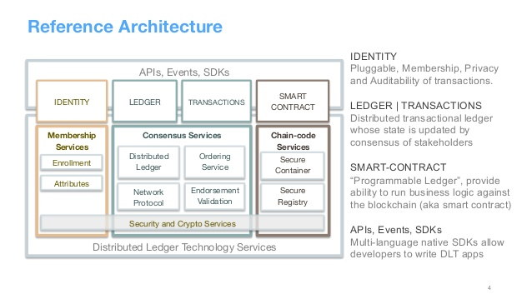
Hyperledger
Notes:
Source: https://www.slideshare.net/BinhNguyen79/blockchain-explored-a-technical-deepdive

Slide 93
What is Hyperledger?
An umbrella project of open source blockchains and related tools
Built by the Linux Foundation on IBM/Intel blockchain projects
More than 100 members
Deliberate choice of not having a coin/value token
Composed of several platforms
Fabric: IBM’s blockchain design and architecture
Sawtooth: Intel blockchain, implements Proof of Elapsed Time (PoeT)
Iroha: Soramitsu Iroha’s blockchain, used by two Japanes companies
Burrow: smart contract machine along the specification of Ethereum
Tooling is available
Implemented in several PoCs where use cases are not monetary
Notes:
The decision of not building a coin strongly shaped the strategic goals of Hyperledger to build industrial applications of blockchain technology and sharply separating it from the get-rich schemes usually evolving from currency based blockchains. This might be more boring, but also more straightforward to the technology.
Tooling:
Cello: Deployment tooling
Composer: Package management tooling
Explorer: Analytics tooling
Indy: Supporting independent identity
Source: https://blockgeeks.com/guides/what-is-hyperledger/

